Slide 1
Workers’ Compensation Adjudicator 2 (WCA2) Apprenticeship at L&I
Catherine Pederson, Claims Specialty Services Program Manager
June 26, 2024

Slide 2
L&I’s Workers’ Compensation Adjudicator 2 (WCA2) apprenticeship program began in 2003.

Slide 3
Why did we do it?
In 2002, interviewed staff about how to improve claims processing
One recommendation was to change the way we were training WCA3s
30-month in-training plan which had “up or out” approach

Slide 4
Why did we do it? Continued…
Determined that there was a critical business need for the majority of claim managers to be WCA2 level
Some positions remained at WCA1 and WCA3
Not all claim managers wanted to be WCA3s
Recruitment and retention difficulties

Slide 5
Current Program
WCA2 apprenticeship is a 22-month program
  3 months of paid Related Supplemental Instruction (RSI) (minimum 500 hours)
  19 months of OJT (minimum 3000 hours)
  Pay progressions at 6, 10, and 22 months

Slide 6
Current Program Continued…
Apprentices are not permanent in their position until they reach journey level (22 months)
  Initial Probation Period: 0-12 months
  Discipline Probation Period: 13-22 months

Slide 7
Hiring
We typically hire 6 apprentice classes per year
  Capacity is up to 13 apprentices per class
  Qualified applicants are required to participate in and pass an assessment prior to being invited for interview
  Assessment includes math and reading comprehension
  Application also requires a typing assessment

Slide 8
How do we measure success?
Robust work checking requirements
  Apprentices must complete a minimum of 671 work check items in 55 different elements
  They must achieve an 80% accuracy rate in the quality of work performed in all categories
  Expected to achieve production expectation of 15 claims per day at end of core training period

Slide 9
What if an apprentice is not being successful?
Apprentices have many resources available to assist them
  Supervisor and unit mentor
  Coach
  Trainers
  Ask L&I
  Critical Breakout Lists (CBL)

Slide 10
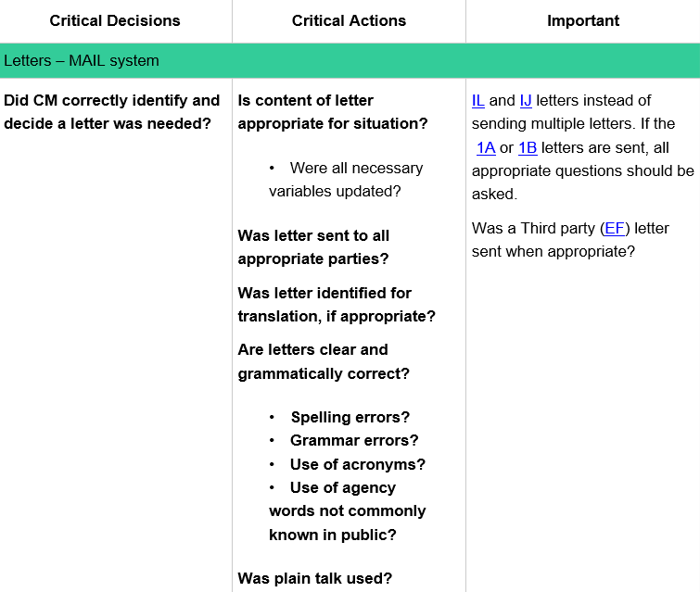

Slide 11
If apprentices aren’t meeting 80% accuracy, can be placed into a Snapshot or Plan for Success
  Snapshot usually comes first (if less than 5 elements)
  Gives apprentice the opportunity to demonstrate proficiency over a specific time period
  Have to submit a required number of claims, and achieve 80% accuracy

Slide 12
Despite best efforts, some apprentices are not successful in their program
  May result in ending employment (if external hire)
  May result in reverting back to prior position (if already a permanent state employee)

Slide 13
Program Highlights
Apprenticeship program is approved for GI Bill
Offers an “earn while you learn” opportunity for a career position with the state
Tiered approach to learning
Every apprentice is assigned a coach for the duration of their program

Slide 14
Challenges
Apprentice Registration Tracking System (ARTS)
Required to use to track apprentice hours and other data
RSI (training) hours and OJT hours must be tracked separately
  Requires manual tracking
Notes:
Must enter apprentice info and various dates into the ARTS system.
We have to manually track all of this data to enter it into ARTS, as our HR systems aren’t able to do the tracking.
Administratively difficult for us due to the large number of apprentices we hire. Smaller program this might be easier.

Slide 15
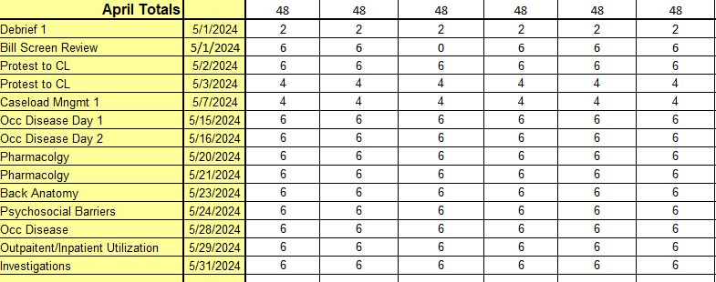
RSI Hours Tracking

Slide 16
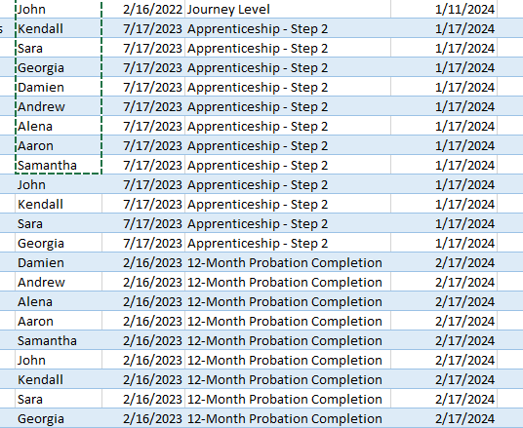
Change of Status Tracking

Slide 17
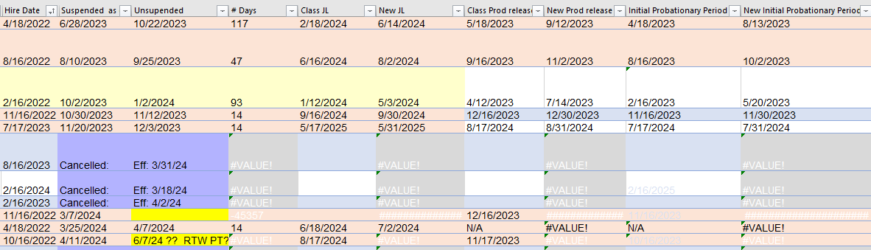
Change of Status Tracking
Notes:
When someone is out for an extended period (example: maternity leave), they go into a change of status that impacts their program dates. Basically, we extend their program dates by the amount of time they are out. This requires more manual tracking on a different spreadsheet. We track: The suspend/unsuspend dates, new journey level date, new production release date, new probationary period end dates. As before, this may be less burdensome for smaller programs.

Slide 18
Resources
Apprenticeship Info for Employers
Laws & Rules for Apprenticeship
WCA2 Apprenticeship Program Standards

Slide 19

Questions?

