Slide 1
Census Tabulation Training
Notes:
Welcome to the Office of Financial Management Tabulation census training.
The Office of Financial Management needs you to summarize the census data you collected on the Field Enumeration Sheet. This presentation will show you how to do that.
During this training, our agency name is abbreviated OFM.

Slide 2
NOTE: This training may contain visual elements that may not be accessible to persons with disabilities, including data forms and geographical maps. If you need assistance accessing any of the information contained in this training, please contact the Office of Financial Management, Forecasting and Research Division, by phone at 360-902-0599, or by email at pop.annexations@ofm.wa.gov
Notes:
This training may contain visual elements that may not be accessible to persons with disabilities, including data forms and geographical maps. If you need assistance accessing any of the information contained in this training, please contact the Office of Financial Management, Forecasting and Research Division, by phone at 360-902-0599, or by email at pop.annexations@ofm.wa.gov
.

Slide 3
Tabulation
Three forms are needed to summarize population and housing by structure type from the completed Field Enumeration Sheet, also known as Sheet A.
  OFM Census Sheet B- Block Tabulation;
  OFM Census Sheet C- Block Group Tabulation; and,
  OFM Census Sheet D- Summary Tabulation.
  These forms need to be completed in the above sequence, following OFM’s instructions.
  Read the Tabulation Manual (http://www.ofm.wa.gov/pop/annex/forms/default.asp ) before you begin tabulating.
  Please have copies of the forms on hand during this session
Notes:
Three forms are needed to summarize population and housing by structure type from the completed Field Enumeration Sheet, also known as Sheet A.
The three forms include:
The OFM Census Sheet B- Block Tabulation;
The OFM Census Sheet C- Block Group Tabulation; and,
And the OFM Census Sheet D- Summary Tabulation.
These forms need to be completed in sequence, following OFM instructions.
Read the Tabulation Manual (http://www.ofm.wa.gov/pop/annex/forms/default.asp) before you begin.
You can choose to fill out the forms by hand or use Excel. The Excel version contains formulas to sum the totals.
For convenience purposes we will refer to the Field Enumeration Sheet as Sheet A, the Block Tabulation Sheet as Sheet B, the Block Group Tabulation Sheet as Sheet C, and the Summary Tabulation Sheet as Sheet D.
Please have copies of the forms on hand during this session.

Slide 4
Best Practices
OFM’s advice is:
Only one or two persons should complete the tabulation forms.
Enumerators should not tabulate their own forms.
Take your time and be careful. Tabulation errors are easy to make.
Notes:
For tabulating, OFM’s advice is:
Only one or two persons should complete the tabulation forms.
Enumerators should not tabulate their own forms.
Take your time and be careful. Tabulation errors are easy to make.

Slide 5
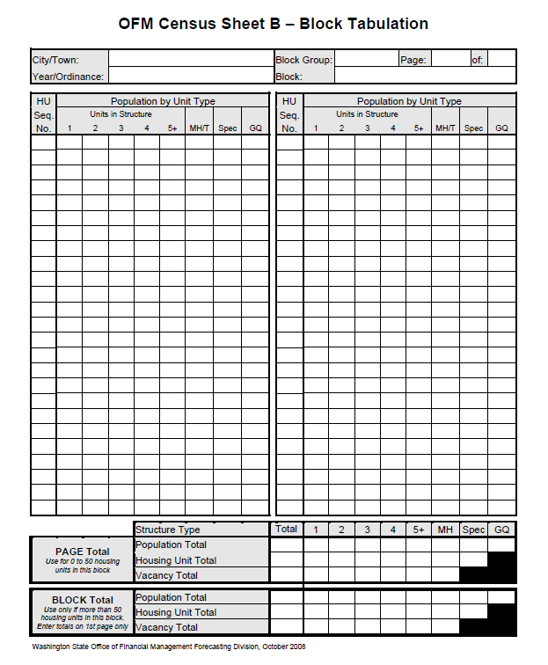
Block Tabulation - Sheet B
Notes:
Sheet B is used to summarize the information from Sheet A.
Sheet B is designed to have one line per housing unit or group quarter for up to 50 housing units or group quarters.
If there are more than 50 housing units in the block, use more forms.
For each new block, use a new Sheet B. DO NOT mix blocks on a single sheet.
Blocks without population and/or housing need a sheet. In this case, the block total would have zeroes.
If the form is completed by hand, please use a pencil so that you can erase errors.

Slide 6
Tabulate Housing Units on Sheet B
Fill out the top portion of the form.
In the first row and first column, enter the Housing Unit Sequence number from Sheet A for the first housing unit.
Move to the right and find the column heading that matches the first housing unit structure type.
Then, enter the number of residents living in that housing unit on that line and column.
The data from one Sheet A should be entered one per line.
Stonesville
11
1
1
2016/1075
1
1
4
Notes:
To complete the Block Tabulation Sheet B, do the following:
Complete the top of the page first. The information includes city name, ordinance number, year, block group number, block number and page number. Click for animation showing those fields filled in
On the first line and first column of the form, enter the Housing Unit Sequence number from Sheet A for the first housing unit. Then locate to the right the column heading that represents the housing unit structure type for that unit.
Enter the resident population from that housing unit on that line and in that column. Click for animation showing those fields filled in
Only one entry per line.

Slide 7
Tabulate Housing Units on Sheet B
Each unit in a multi-unit structure receives a separate housing unit sequence number and is entered on a separate line.
Record all population in all housing units in the block in the same manner. Each Sheet B has room to record 50 housing units/facilities. Use more sheets for the block as needed.
If the housing unit is vacant, it is still recorded on the sheet. Enter a “V” for vacant.
Stonesville
11
1
1
2016/1075
1
1
4
3
2
3
3
4
V
5
1
6
1
7
2
8
V
9
4
Notes:
Each unit in a multi-unit structure receives a separate housing unit sequence number and is entered on a separate line.
Record all population in all housing units in the block in the same manner. Use more sheets as needed. Click for animation showing the housing unit sequence number and structure type filled in
If the housing unit is vacant, it is still recorded on the sheet. Enter a “V” for vacancy. Do not put down “0”. If you use the Excel version of the form, the formulas will sum the number of vacancies correctly only if you use a “V”.

Slide 8
Tabulate Special Housing on Sheet B
On the next blank line find the “Spec” column and enter the number of residents.
Do enter a housing unit sequence number
No vacant specials are allowed.
Write the type of Special Housing on the line. If you are using the Excel file, write the type of Special Housing after the form is printed. Entering it on the form before printing will mess up the formulas.
Stonesville
11
1
1
2016/1075
1
1
4
3
2
3
3
4
V
5
1
6
1
7
2
8
V
9
4
10
Boat
1
Notes:
If a special housing unit is enumerated, find the “Spec” column and enter the number of residents on the next line. Click for animation showing special housing unit filled in on form
Do not enter a “0” or a “V” for a special housing unit. Specials are not considered a housing unit unless it is occupied.
Do enter a housing unit sequence number.
Write the type of Special Housing Unit on the line. If you are using the Excel file, write the type of Special Housing after the form is printed. Entering it on the form before printing will mess up the formulas.

Slide 9
Tabulate Group Quarters on Sheet B
If a GQ is enumerated, find the GQ column and enter the number of residents on a new line.
Do not enter a housing unit sequence number.
Write the type of GQ on the line. If you are using the Excel file, write the type of GQ after the form is printed. Entering it on the form before printing will mess up the formulas.
Stonesville
11
1
1
2016/1075
1
1
4
3
2
3
3
4
V
5
1
6
1
7
2
8
V
9
4
10
Boat
1
10
Nursing Home
Notes:
Information for a group quarters facility is recorded on Sheet B. But there is a difference.
On the next blank line, find the GQ column and enter the number of residents. Do not assign a housing unit sequence number since it is not a housing unit.
Write the type of GQ on the line. If you are using the Excel form, write the type of GQ after the form is printed. Entering the type on the form before printing will mess up the formulas.

Slide 10
Summarize Totals on Sheet B
At the bottom of the form, enter the page totals by structure type in the “Page Total” portion.
If there is more than one sheet, each page should have its own Page Total.
The “Block Total” portion is the sum of two or more Page Totals in the same block. Only one Block Total is needed and should be on the first sheet.
If there is only one Sheet B for a block, the Block Totals section is left blank.
Stonesville
11
1
1
2016/1075
1
1
4
3
2
3
3
4
V
5
1
6
1
7
2
8
V
9
Boat
4
1
10
Nursing Home
10
29
4
6
7
1
1
10
10
2
2
4
1
1
1
1
0
2
0
10
Notes:
At the bottom of the form, enter the page totals by structure type in the “Page Total” portion. Count the number of housing units by structure type and enter the number in the appropriate line and columns. Include vacant units in the housing totals. There are no vacancy entry for specials or GQ facilities.
If more than one sheet is needed for a block, each page should have its own Page Total.
If you are filling out the form in Excel, page totals will be calculated automatically for you.
If more than one Sheet B is needed, you need to complete the “Block Total” portion by summing all Page Totals in the same block, and it should be recorded on the first sheet only.

Slide 11
Commonly Made Mistakes in Tabulation

Slide 12
Mistake 1: Entering All Data in One Column
All data were entered in the single family housing column regardless of structure type.
This leads to a lot of extra work both for you and OFM
Stonesville
11
1
1
2016/1075
1
1
4
2
3
3
3
4
V
5
1
6
1
7
2
8
V
9
4
Boat
10
1
Nursing Home
10
6
1
29
4
7
1
10
1
10
2
2
4
1
1
1
2
0
0
Notes:
The first common mistake is that all data is put to put in the single family housing column regardless of structure type. This will result in housing being misclassified as single family housing on the page totals if entered in excel. When Page Totals are calculated by hand, occasionally the Page totals are correct even though the entries above are wrong.
Either way, to correct this mistake every single Sheet A must be re-entered in the block. This doubles the amount of work for both the city and OFM.

Slide 13
Mistake 2: Counting Housing Rather than Population
Instead of entering the number of persons for each housing unit, a "1“ is often entered.
Stonesville
11
1
1
2016/1075
1
1
1
1
2
1
3
4
1
1
5
6
1
7
1
8
1
9
1
10
Boat
1
Nursing Home
10
29
4
6
7
1
10
2
2
1
1
10
4
1
1
1
2
0
0
Notes:
Population, and not the number of housing units, should be entered into the cells on Sheet B. Some people get confused and enter number “1” instead of the number of people in the cells. This mistake takes a lot of time to correct.

Slide 14
Mistake 3: Not Labeling Special Housing Unit/
GQ Types
Sometimes, GQ and Special unit type information are not included on Sheet B.
Stonesville
11
1
1
2016/1075
1
1
4
3
2
3
3
4
V
5
1
6
1
7
2
8
V
9
Boat
4
1
10
Nursing Home
10
29
4
6
7
1
10
2
2
1
1
10
4
1
1
1
2
0
0
Notes:
Another common mistake is not entering the type of group quarters or special housing unit type on the same line as the population is entered. Click for animation Entering this information saves you time for tabulation work on the final Summary Sheet.
If you are using the Excel file, write the type after printing the form. Typing them in the form can cause some formulas problems.

Slide 15
Mistake 4: Vacant Housing Units Data Entry
A zero “0” is entered for a vacant unit rather than a “V.”
Stonesville
11
1
1
2016/1075
1
1
4
3
2
3
3
4
0
5
1
6
1
7
2
8
0
9
Boat
4
1
10
Nursing Home
10
29
4
6
7
1
10
2
2
1
1
10
4
1
0
0
0
0
0
Notes:
The last common mistake is a “0” is often entered for vacant housing units. On Sheet B, vacant housing should be tabulated by entering a “V”. Click for animation showing zeros appear. A zero can lead to mis-tabulation of vacant units. The eye often misses the “0” when counting vacancies.
If you are using Excel, the formulas will not count the vacancies if a “0” is entered. The formulas only recognize “V’ to sum for vacancy.

Slide 16
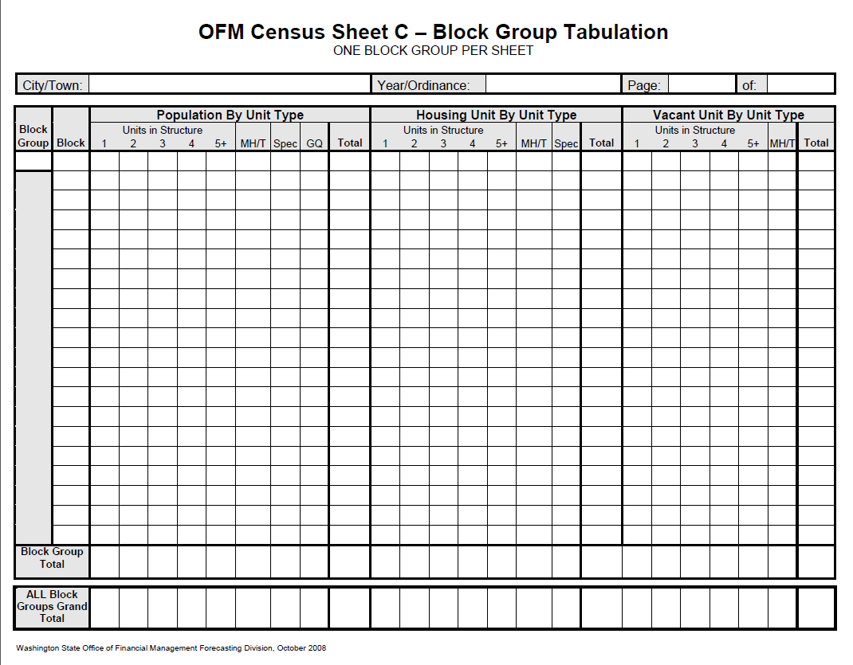
Block Group Tabulation - Sheet C
Notes:
Block level data from Sheet B are summarized to Block Group level on Sheet C. One block group is equivalent to one supervisor areas. Data from the Sheet B can be transferred to Sheet C as each block is completed, or when all blocks are completed. Whichever method is used, please be consistent in order to minimize problems.

Slide 17
Tabulate Sheet C
  Complete the top portion of the form like for Sheet B with city/town name, year/ordinance, and page number.
  If the block group contains more than 20 blocks, use multiple sheets.
  Do not record two block groups on the same sheet.
Stonesville
2016/1075
1
1
17
Notes:
Again, complete the top portion of the form like you did for Sheet B with city/town name, year/ordinance, and page number. Click for animation
If the block group contains more than 20 blocks, use multiple sheets.
Do not record two block groups on the same sheet.
You can choose to fill Sheet C out using paper or Excel.

Slide 18
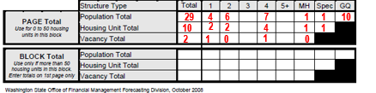
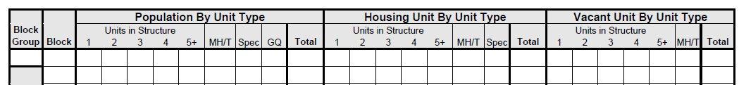
Transfer Information from Sheet B
Sheet B
Sheet C
11
1
4
6
7
1
1
10
29
2
2
4
1
1
11
1
0
1
0
2
Notes:
On Sheet C enter one Sheet B block’s data per line. In the first column, enter block group number.
Take your first Sheet B and enter the block number in the next column on the first line.
Transfer all block total information from the bottom of Sheet B to Sheet C.
Click for animation The population total on sheet B, highlighted in blue, should be transferred to the “Population by Unit Type” section on sheet C;
Click for animation Housing unit totals, highlighted in green, should be transferred to “Vacant Unit by Type” section on sheet C;
Click for animation Vacant totals, highlighted in orange, should be transferred to “Vacant Unit by Type” section on sheet C.

Slide 19
Sum to Totals at Bottom of Page
Stonesville
2016/1075
1
1
11
1
4
6
7
1
1
10
29
2
2
4
1
1
11
1
0
1
0
2
4
6
7
1
1
10
29
2
2
4
1
1
11
1
0
1
0
2
Notes:
Once you finish tabulating all the blocks, enter the totals at the bottom of the page in the Block Group Total line. Click for animation
If more than one form is used for one block, the All Block Groups Total should be entered on the first page.
As the last step, you need to use a blank Sheet C to sum all Sheet Cs and get a census total. Enter the block group total from each Sheet C in the upper table section and add each column to a census total.
Double Check: Be sure to balance your totals both vertically and horizontally. Again, compare grand totals for population, housing, and vacancies with totals derived from the Sheet Bs and Sheet As.

Slide 20
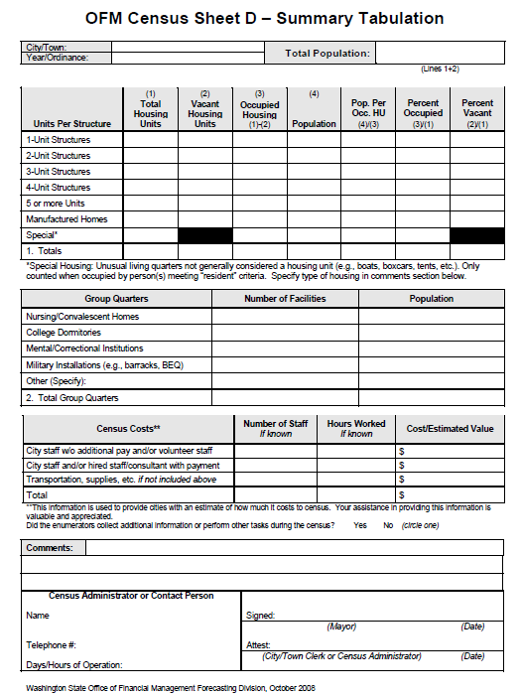
Final Summary Tabulation - Sheet D
Notes:
Sheet-D is used for the final summary of population and housing and is submitted to OFM for certification of the census results. At this point, every callback should either be resolved or classified as vacant, every Sheet B and Sheet C should be completed and balanced.

Slide 21
Completing Top Section - Sheet D
Complete the top part of the form with city/town name and ordinance number
Enter census total population in the box to the right. It is the sum of total population (line1 col.4) and group quarter population (line 2, col. 2)
Stonesville
2016/1075
Notes:
Complete the top of the form with city/town name and year/ordinance number. Click for animation
Enter census total population in the box to the right. It is the sum of total population (line 1, col. 4) and group quarter population (line 2, col. 2)

Slide 22
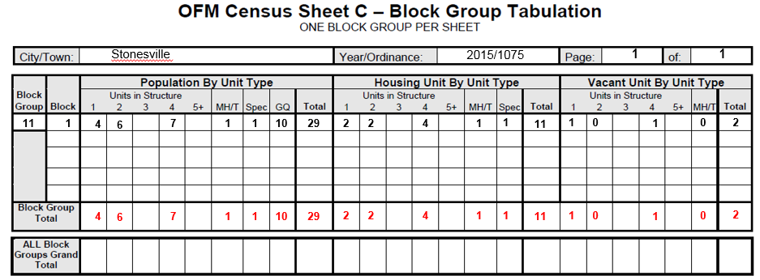
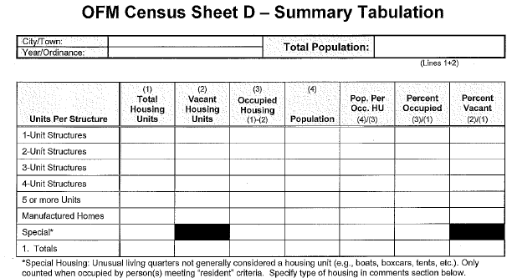
Complete Housing Unit Portion - Sheet D
Stonesville
29
2016/1075
2
1
4
2
0
6
4
1
7
1
0
1
1
1
10
2
19
Notes:
In 2nd section you need to transfer population, housing and vacancy from the final Sheet C that contains census total to Sheet D.
Click for animation In Column 1 enter the number of housing units by structure type from the final Sheet C. Each type of housing unit structure has a separate line.
Click for animation In Column 2, enter the vacant housing unit data from the final Sheet C. Again, each type of housing unit structure has a separate line.
Click for animation In Column 4, enter the population by structure type from the final Sheet C. Do not enter GQ population in this column.
It is optional to compute the calculated values in the other columns. If you are using the Excel file, the formulas will calculate the values for you.

Slide 23
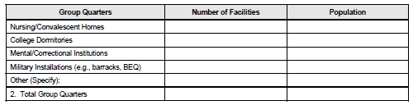
Complete the GQ Section - Sheet D
1
10
1
10
1
10
Notes:
The third section of Sheet D is for reporting GQ information.
Click for animation In the first data entry column, enter the number of facilities by type of facility. Refer to your notes on Sheet B.
In the second column, enter the population by type of facility. Refer back to your notes on Sheet B. Be sure the final tabulations, by type of facility, are consistent with the total GQ population shown on the Sheet C containing the census total.
Click for animation Total the number of facilities and population on line 2.

Slide 24
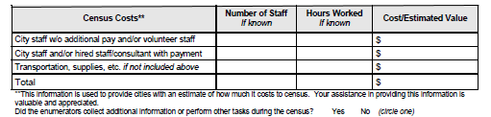
Census Costs Portion of Sheet D
Notes:
The fourth section requests an approx. estimate of census costs and is optional. This information helps OFM to respond to cost questions.

Slide 25
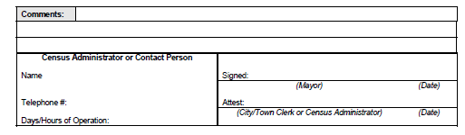
Complete the Rest of Sheet D
The special is a boat.
Jim Jones
Alice Smith
360-555-1234
Linda Mayes
8 - 5
Notes:
The fifth section is where you can enter comments as desired and get signatures and contact information.
Click for animation The mayor and city clerk or census administrator need to sign this form. This ensures that the final figures are known to the mayor.
Click for animation The person’s name and contact information requested to the left of the signatures should be the person OFM, or you, can call if there are questions about the census material. This is crucial information. OFM will not certify a census until all questions by OFM are answered.
Click for animation Add comments about specials, GQ’s, or an unusual experience with a housing unit in the field.

Slide 26
Finish Tabulation
  Double check your work
  Resolve all questions before submitting to OFM. Consult your Tabulation Manual and give us a call if you have any questions. We’re here to help! Our number is (360) 902-0599.
  Remember to submit all Field Enumeration Sheets – Sheet A (making no copies) along with your tabulation sheets.
  If you made Excel copies of sheets B, C, and/or D delete them upon OFM receipt.
Notes:
Double check your work
Resolve all questions before submitting to OFM. Consult your Tabulation Manual and give us a call if you have any questions. We’re here to help! Our number is (360) 902-0599.
Remember to submit all Field Enumeration Sheets – Sheet A (making no copies) along with your tabulation sheets.
If you made Excel copies of sheets B, C, and/or D delete them upon OFM receipt.

