Slide 1
Census Mapping Training
Notes:
Welcome to the Office of Financial Management census mapping training.
As mentioned in the Administrator training section, maps are very important for a successful census Maps help make sense and order of the census area. They are used to keep track of progress, define the census area, help eliminate confusion, define supervisor and enumerator areas, and much more.
The mapping and examples in this section, will be referenced in relation to an annexation census. The mapping techniques for an annexation census and a city census are exactly the same. A city census map usually involves larger areas and larger size maps that are hard to show effectively in a presentation. So, examples are shown from an annexation census.
All maps in this training are real maps. Outlined annexation areas may not be real and are just for demonstration purposes. Basic map terminology and definitions have been presented in the Administrator Training and are not repeated here.
If you have questions, you can always contact OFM Forecasting and Research. Contact information is found at the end of this presentation.
During this training, our agency name is abbreviated OFM.

Slide 2
NOTE: This training contains visual elements including data forms and geographical maps. To meet accessibility standards, visual elements are tagged and/or described in readable text. If you have any difficulty or need assistance accessing any of the information contained in this training, please contact the Office of Financial Management, Forecasting and Research Division, by phone at 360-902-0599, or by email at pop.annexations@ofm.wa.gov
Notes:
NOTE: This training contains visual elements including data forms and geographical maps. To meet accessibility standards, visual elements are tagged and/or described in readable text. If you have any difficulty or need assistance accessing any of the information contained in this training, please contact the Office of Financial Management, Forecasting and Research Division, by phone at 360-902-0599, or by email at pop.annexations@ofm.wa.gov

Slide 3
Maps
There are three different levels of maps for use by different people:
Master Control Map: This map shows the entire census area. It is generally on the wall of the main census office. Everybody can see it and refer to it. Since it can be marked to show progress, this map is very valuable for control purposes.
Supervisor Map: If a census area is large enough, the administrator cannot supervise all employees directly. So, the area is subdivided into smaller areas. One supervisor is in charge of the census in a subdivided area. The supervisor is to receive a map of their area only.
Enumerator Map: Each supervisor is in charge of several enumerators and each enumerator will receive a map of a subdivided supervisor area
Copies of each type of map are shown on the following slides.
Notes:
There are three different levels of maps for use by different people:
Master Control Map: This map shows the entire census area. It is generally on the wall of the main census office. Everybody can see it and refer to it. Since it can be marked to show progress, this map is very valuable for control purposes. Only one Master Control Map is needed.
Supervisor Map: If a census area is large enough, the administrator cannot supervise all employees directly. So, the area is subdivided into smaller areas. One supervisor is in charge of the census in a subdivided area. The supervisor is to receive a map of their area only.
Enumerator Map: Each enumerator will receive a map of a subdivided supervisor area.
Copies of each type of map are shown and discussed on the following slides.

Slide 4
Preparation of the Master Control Map
The Master Control Map is critical to census success and must be as accurate as possible. This is the administrator’s job.
The administrator needs to:
Make the map an appropriate scale. This map will not be used in the field so the scale can be zoomed in for clear reference and marking. This map should be on display at all times in the census room. A good scale would be 1”=400”. Also, 1”=800” would work.
Mark the following on the map so the enumerator can be prepared to handle the situation:
  Group quarters facilities
  Congregate care
  Security apartments/gated communities
  Large apartment complexes
  Manufactured home parks
  Motels/hotels
Notes:
The Master Control Map is critical to census success and must be as accurate as possible. The administrator needs to:
Make the map an appropriate scale. This map will not be used in the field so the scale can be zoomed in for clear reference and marking. This map should be on display at all times in the census room. A good scale would be 1”=400”. Also, 1”=800” would work.
Mark the following on the map so the enumerator can be prepared to handle the situation:
Group quarters facilities,
Security apartments/gated communities
Large apartment complexes
Manufactured home parks
Motels/hotels

Slide 5
Preparation of the Master Control Map
Field check and update the map:
  Use white-out or tape to remove non-existent roads and mark full or partial closures.
  Add new roads
  Clarify potential boundary problems
  Mark physical barriers such as railroad tracks, rivers/creeks/ditches, and anything that affects enumerator travel
Notes:
After getting a map of the census area, you need to field check and update the map:
Use white-out or tape to remove non-existent roads and mark full or partial closures.
Add new roads.
Clarify potential boundary problems
Mark physical barriers such as railroad tracks, rivers/creeks/ditches, and anything that affects enumerator travel

Slide 6
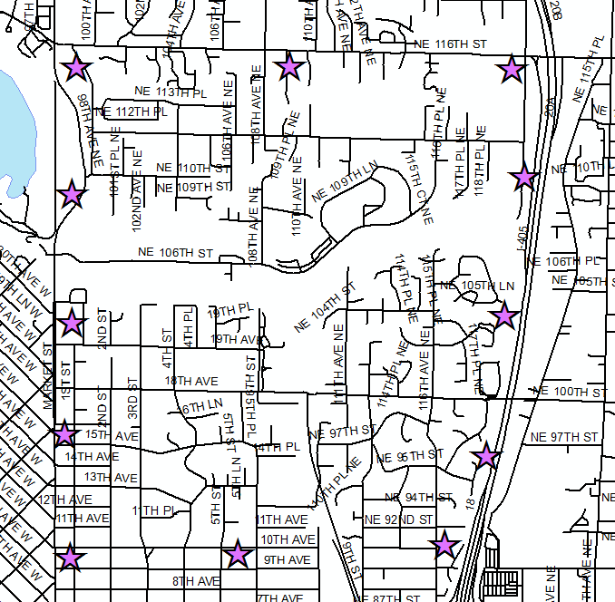

Master Control Map
Notes:
This is an example of a map that is ready to be marked into a master control map.
This map shows the entire annexation area. The purple stars show the approximate boundary of the area that was annexed.
All changes from the administrator field survey have to be put on the map. These include street changes, location of group quarters, barriers to enumerators, etc.
When printed out, the scale will be such that all parts of the area will be legible and can be labelled/modified as needed.
Streets are drawn with names. For convenience, the streets should be represented by parallel lines.
North arrow is present
The Master Control Map must be marked and labelled in a specific manner. Beginning with the next slide, you will learn how to mark/label the map properly in different stages. Preferred colors are green, red, orange, and black. The specific colors will be mentioned when they are to be used. Definitions and concepts introduced in other training sessions will be used without repeating the definitions.

Slide 7
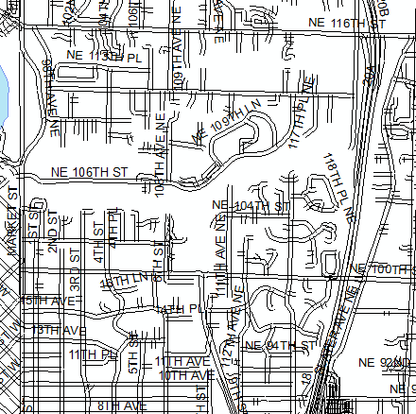
Step 1: Marking Census Boundary and
Supervisor Areas
1
1
2
3
Notes:
This is the master control map with the boundaries outlined in color.
The green lines represent the municipal boundaries before the annexation.
The red line represents one boundary of the annexation area. In this map, the red boundary is the annexation boundary with the unincorporated county.
Determine how many supervisors are needed and outline their areas with orange. The Administrator must decide where the supervisor boundaries are. Several factors must be taken into account when making the boundaries. Each supervisor area should have approximately the same amount of work no matter the size of the area. The factors to take into account are:
Hostility to the annexation
Number of housing units
Housing unit structure type
Density of housing units
Effect of geography on enumeration
Weather at time of census.
Time of the year (holidays significantly affect who is at home or away)
In our example, the city expects to hire three supervisors and has divided up the area appropriately. Supervisor areas, on our forms, are the equivalent of Block Groups on the tabulation sheets.
Area 2 has more housing units and more housing unit density. Enumerators will walk more and drive less
Area 3 has fewer housing units and less density. Enumerators will walk less and drive more. This results in fewer housing units canvassed in an hour.
Area 1 has features of both Area 2 and Area 3
These factors are discussed in more detail in the Administrator’s training session, slide 17.

Slide 8
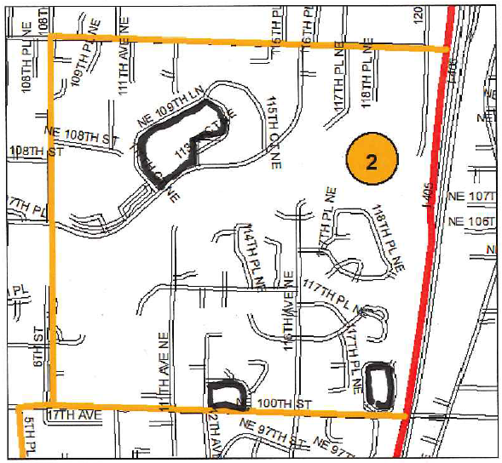
Step 2: Marking Enclosed Blocks
Notes:
In order to show the examples better, supervisor area #2 will be our example map.
After the boundaries have been drawn, the individual blocks need outlining in black.
A good practice is to look for and outline all enclosed blocks first. The majority of enclosed blocks are square or rectangle, but some can be in different shapes. (If you need to refresh your memory, block information can be found in the enumerator training, slides 27 to 31.) Get out your black Sharpie and go to an enclosed block. On the inside parallel line, trace around the block. Be sure to follow around cul-de-sacs and other dead end streets.
The black line should represent the path of the enumerator as they travel clockwise from the northeast corner around the block. Remember the enumerator should be able to stop at the same place they started without crossing a street. Exceptions to path rules are made for safety reasons. For example, when a one-way street is a boundary you may decide to go in the direction of traffic. This makes supervisor quality control checks, often done in a car, easier.

Slide 9
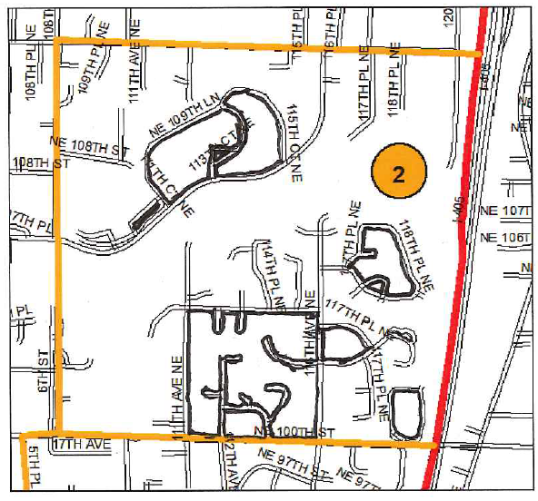
Step 2: Marking Enclosed Blocks
Notes:
This map shows all enclosed blocks marked in black. The outlining follows the shape of the block. The marking follows all streets, including the cul-de-sacs and other dead end streets that extend into the block.
Notice that there are some unmarked blocks. These are the unenclosed blocks found in this area.

Slide 10
Step 3: Marking Unenclosed Blocks
Notes:
On this master control map, all enclosed blocks have been outlined in black first. The unenclosed blocks now need outlining. The majority of unenclosed blocks are not square or rectangle. They are different shapes. (if you need to refresh your memory, block information can be found in the enumerator training video, slides 27 to 31.)
Get out your black Sharpie and go to the unenclosed block going through the middle of the area. The “2” identifying the supervisor area is in the middle of it. (For better viewing definition, the example outlining is shown in blue.) This unenclosed block is the largest in this area. There are two non-street boundaries: one on the west and one on the east. Locate them and draw dashed lines. GREEN ARROWS show their location. Finally, connect the ends of the dashed lines with a straight line. This line will be along streets and there are two of them. Since there are two non-street boundaries, you will need two non-dashed lines.

Slide 11
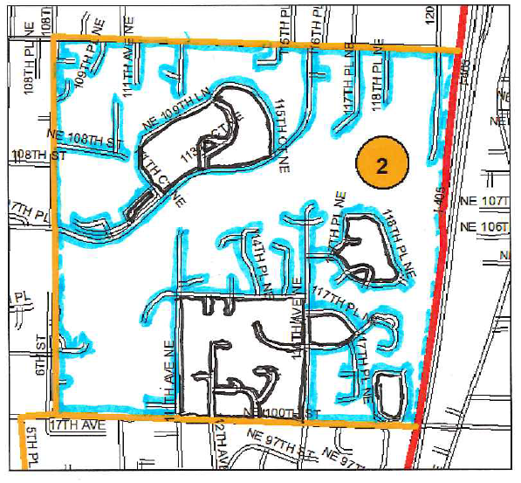
Step 3: Marking Unenclosed Blocks
Notes:
This map shows all enclosed blocks marked in black and unenclosed marked in blue.
The largest block in supervisor area #2 needs subdividing into manageable sections. Evaluate the block. Note areas that would make good boundary places: areas with no housing units, back sides of developments (they are usually fenced and make good dividing lines). Any area with well defined characteristics or devoid of buildings would be good for using as a non-street block boundary. In supervisor area #2, the dividing dashed lines were placed based on a few vacant parcels or back fences of developments.

Slide 12
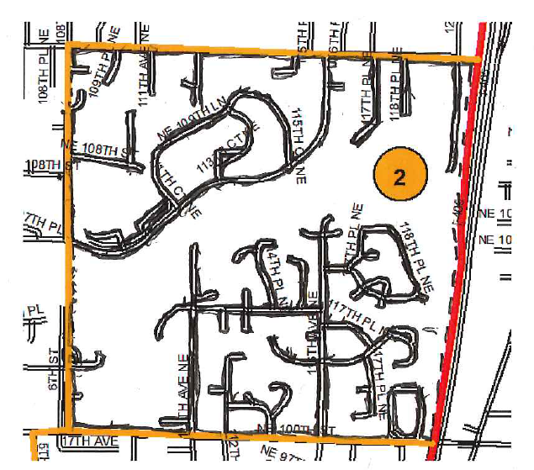
Numbering Blocks on a Master Control Map
2
1
3
4
7
5
6
8
10
9
11
13
12
14
15
17
18
16
Notes:
After outlining blocks in black, they are numbered in a serpentine manner starting with “1.” In this example, the numerals were written in red to be seen better. Block numbering should restart with “1” in each supervisor area. Or, block numbering can start with “1” and continue for the entire census area. In the latter case, the numbers can get high. Overall, it is better to start with “1” in each supervisor area. Some labels can be written outside their blocks with arrows pointing to the correct block. If you accidentally skip a number, do not worry. These are labels only and do not represent a count. Make a note to remind yourself of a missing block number
A serpentine manner means starting at the upper left or right, with “1”. Then move horizontally incrementing the number. When you reach the opposite side of the map, go down a level and continue numbering in the opposite direction. Continue in this manner until all blocks are numbered. Adjust path as necessary. A perfect serpentine path is not always possible.

Slide 13
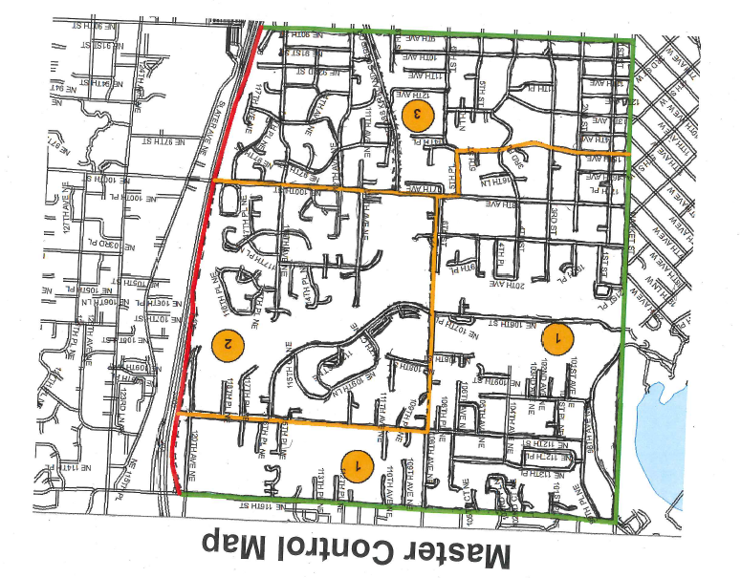
Master Control Map
1
2
3
5
8
7
6
4
6
9
10
11
12
13
1
6
14
2
3
4
8
15
7
5
14A
19A
9
10
8
16
17
11
19
18
13
20
22
23
14
15
21
16
17
18
28
27
26
24
7
8
9
12
29
29A
25
6
25A
1
2
5
12
11
10
25
24
3
4
13
14
26
24A
23
22
20
18
15
39
27
28
21
19
17
16
38
32
29
30
41
40
37
36
35
34
33
31
Notes:
This map shows the completed Master Control Map for all three supervisor areas.

Slide 14
Supervisor Maps
Next, prepare the supervisor maps.
For a large census, the area needs to be subdivided so that each supervisor has separate maps for his/her areas.
A good map scale would be 1”=800’. Other scales work also. Just make sure the map is useable for the supervisor.
At least two unmarked master control maps will be needed to create one set of supervisor maps. If three or more areas meet in one place or near each other, the number of maps required needs increasing.
The main maps will be cut to show the supervisor areas and a little extra area around it.
Blocks and block numbering must be the same as on the master control map.
Notes:
The next step is to prepare supervisor maps.
For a large census, the area needs to be subdivided so that each supervisor has separate maps for his/her areas.
At least two unmarked master control maps will be needed to create one set of supervisor maps. If three or more areas meet in one place, the number of maps required needs increasing. The main maps will be cut to show the supervisor areas and a little extra area around it. The little extra on the cutout is to help orient the supervisor. Since supervisors have no responsibilities outside their area, they have no need for a full map. Except, if they do not know the area and need one for the purpose of finding their area. A complete map would have no other function for a supervisor.
Blocking and block numbering are done after the supervisor maps are cut. Blocks must have the same numbering as shown on the master control map. This way his/her assigned blocks only are highlighted by the outlining. The “little extra” area blocks are not marked at all.
A supervisor map is shown on the next slide.

Slide 15
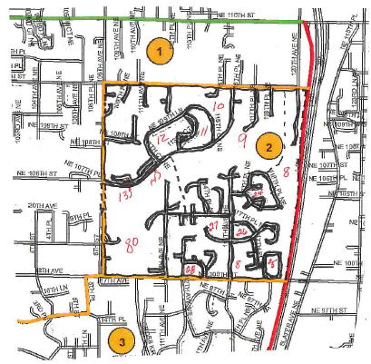
Supervisor Maps
1
2
4
6
7
5
3
8
10
11
9
12
15
13
14
17
16
18
Notes:
This map shows supervisor area number 2. The inner area in white is the supervisor’s area of responsibility. The areas with the blue overlay show area outside of the supervisor #2 area. The area is shown in blue for illustrative purposes only. The blocks in the white area only are outlined in black and are numbered. The block numbering must match the master control map. The blue area blocks are not outlined in black and are not numbered. These areas are included on the map to give some assistance in orienting a supervisor to his/her location in the field. Street names need to be present.

Slide 16
Enumerator Maps
The supervisors need to prepare the enumerator maps. Enumerator maps guide canvassers to their assigned blocks. Map scale should be of the same scale as a supervisor map or larger.
As with the supervisor maps, at least two unmarked maps will be needed to create one set of enumerator maps.
Except for the areas outside the assigned area, these maps should duplicate the Master Control Map blocking and numbering.
The enumerator maps can represent either a daily or an entire census assignment.
An enumerator map example is shown on the next slide.
  The blue areas shown are not to be marked in any way. These areas are outside the assignment area and for reference.
  They are not to have a blue overlay.
Notes:
Next, the supervisors prepare the enumerator maps. Enumerator maps are used in the field to guide canvassers to their assigned blocks. Map scale should be of the same scale as a supervisor map or larger.
At least two unmarked master control maps will be needed to create one set of enumerator maps. If three or more enumerators have a common or near common meeting point, three or more maps will be needed.
Extra area surrounding the assigned area will be needed. This helps the enumerator orient themselves in the field.
The enumerator areas as are not shown on the Master Control Map but do duplicate the blocking and numbering.
Enumerator maps can identify either daily or an entire census assignment.
An example is shown on the next slide. The blue areas are outside the enumerator’s assigned area and are for reference. The blue overlay is just for example in this presentation.

Slide 17
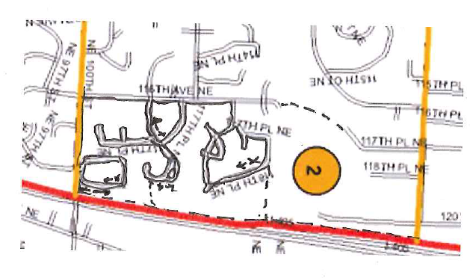
Enumerator Maps
10
11
9
12
13
17
18
Notes:
The Enumerator maps show the area/blocks that one enumerator/team canvasses.
Like the supervisor map, the map shows a little extra area for purposes of orienting the enumerator (area highlighted in blue-it is colored blue for illustrative purposes only). Notice that no block markings/coding show outside the enumerator area.
All block information marked on the map in the assigned area should be the same as on the master control map.
All blocks should be marked with an “x” and a line with an arrowhead. As mentioned in the enumerator training session, the “x” should be placed in the northeast corner of the block or as close as practical. Some blocks, especially unenclosed, will have the “x” significantly distant from the northeast corner. This is usually because this area is where there are no roads. What you do is imagine a clockwise path and put the “x” at the first chance to enumerate. The enumerator will then continue in a clockwise route.

Slide 18
Summary
Maps are the major organizational tool of a census,
Without a map properly updated, marked, and a useable scale, a census could go wrong.
If there is any sign of potential problems, please contact the Office of Financial Management, Forecasting and Research Division, Population Studies Unit at the following phone number: 360-902-0599
We will assist you in any way we can.
Notes:
Maps are the major organizational tool of a census,
Without a map properly updated, marked, and a useable scale, a census could go wrong.
If there is any sign of potential problems, please contact the Office of Financial Management, Forecasting and Research Division, Population Studies unit at the following phone number:
Forecasting and Research Division: 360-902-0599
We will assist you in any way we can.

