Slide 1
Census Worker Training for A Small Census
Notes:
Welcome to the Office of Financial Management census worker training.
This training is addressing a smaller census of about 50 housing units with no group quarters or other special circumstances. If your census is larger or has group quarters, special housing, large and/or gated apartment complexes you should refer to the training for larger censuses.
Typically smaller censuses are conducted by one or two staff members. However, sometimes the city or town will hire one or two individuals to conduct a census. If you plan to hire staff you may want to review the Census Administrator Training for a larger census for some additional considerations regarding hiring.
During this training, our agency name is abbreviated OFM.

Slide 2
NOTE: This training contains visual elements including data forms and geographical maps. To meet accessibility standards, visual elements are tagged and/or described in readable text. If you have any difficulty or need assistance accessing any of the information contained in this training, please contact the Office of Financial Management, Forecasting and Research Division, by phone at 360-902-0599, or by email at pop.annexations@ofm.wa.gov
Notes:
NOTE: This training contains visual elements including data forms and geographical maps. To meet accessibility standards, visual elements are tagged and/or described in readable text. If you have any difficulty or need assistance accessing any of the information contained in this training, please contact the Office of Financial Management, Forecasting and Research Division, by phone at 360-902-0599, or by email at pop.annexations@ofm.wa.gov

Slide 3
Table of Contents
General Information and Pre-census Preparation
Housing Unit Definitions
Canvassing Procedures
How to Fill Out the Field Enumeration Sheet
Frequently Asked Questions, Important Considerations, and Paperwork Submittal
Notes:
This training session is organized into 5 parts
General information and Pre-census preparation
Housing Unit Definitions
Canvassing Procedures
How to Fill Out the Field Enumeration Sheet
Frequently Asked Questions, Important Considerations, and Paperwork Submittal

Slide 4
General Information and Pre-census Preparation
Notes:
This is Section 1, General Information and Pre-census Preparation

Slide 5
Must Keep Information Confidential
  The Census information that you collect is confidential and protected by law.
  Copied below is RCW 42.56.615 that guarantees confidentiality.
RCW 42.56.615
Enumeration data used by the office of financial management for population estimates.
Actual enumeration data collected under RCW 35.13.260, 35A.14.700, 36.13.030, and chapter 43.62 RCW shall be used and retained only by the office of financial management and only for the purposes of RCW 35.13.260, 35A.14.700, 36.13.030, and chapter 43.62 RCW. The enumeration data collected is confidential, is exempt from public inspection and copying under this chapter, and in accordance with RCW 43.41.435, must be destroyed after it is used.
[ 2014 c 14 § 1.]
Notes:
All the information you collect is confidential and is protected by law. Tell no one about anything you learn. If someone insists on looking at your paperwork, lock the paperwork in your car. No one is allowed to see the sheets except you and others working on the census. This includes law enforcement, elected officials, city government staff, coworkers and regular citizens. Copied below is RCW 42.56.615 that guarantees confidentiality.
If someone wants to pursue disclosure, he/she has to file a public records request with the Office of Financial Management in Olympia. RCW 42.56.615 protects the confidentiality of the data collected. Any request for census data will be denied. There is no exception.

Slide 6
Census Quality
A census is an investment of time and resources for both the city and OFM.
Census workers must follow OFM specifications to achieve a quality census that OFM will approve.
OFM may reject all or parts of a census where census workers failed to follow OFM procedures.
A rejected annexation census will result in a partial or total re-do of the census.
Notes:
A census is an investment of time and resources for both the city and OFM. In order to ensure the quality of the census, OFM has developed specific procedures and rules as to how the census should be conducted. During the certifying process, all the census sheets will be reviewed. It is OFM’s responsibility to ensure that all the housing units and residents are appropriately counted. A census with many obvious duplicates or missing names, or that is disorganized and/or incomplete, can be wholly or partially rejected by OFM.
For an annexation census this means the whole census or certain sections need to be re-canvassed at the city’s expense.

Slide 7
Identify Census Window
  A census should be completed within 30 days.
An annexation census cannot start before it is legally effective. And, by statute, the documentation has to be sent to OFM within 30 days of the effective date.
  With preapproval, the enumeration period may be extended up to two weeks prior to the effective date.
Notes:
A census should take no more than 30 days from the first day in the field to mailing it in to OFM.
An annexation census cannot start before it is legally effective. A city has no jurisdiction in the annexed area until it officially becomes part of the city. With preapproval from OFM the enumeration period may be extended up to two weeks prior to the effective date.

Slide 8
Use City Staff vs Hire Contractor
Use an estimated population for the area to get a sense of the time needed.
If census workers will be comprised of city staff, make sure their other duties will not conflict with census work. Census work takes priority. Weekend and evening hours should be required.
If city staff do not have the time/skills needed to conduct a census, consider hiring a contractor to do the entire census.
If you decide to hire a contractor keep in mind that for a smaller census they may need to be onboard 1 week before fieldwork begins.
The contractor must use OFM training materials him/herself and understand the requirements.
The city must monitor the contractor and make sure OFM requirements are being followed.
Notes:
A city must decide whether to conduct the census on its own or to hire a contractor. Here are some considerations:
Use an estimated population for the area to get a sense of the time needed.
If the census workers will be comprised of city staff, make sure other duties will not conflict with census work. Census work takes priority. Remember, weekend and evening hours should be considered as those are the best times to capture residents at home.
If city staff do not have the time/skills needed to conduct a census, consider hiring a contractor to do the entire census for the city.
If you decide to hire a contractor, keep in mind that they may need to be onboard 1 week before fieldwork begins depending on the size of the census and the amount of preparation needed.
Make sure the contractor has read the manuals. If the contractor is new, they should contact OFM directly regarding the training and preparation they need to make before starting the census.
Even if a contractor is hired, it is still the city’s responsibility to ensure the census meets OFM’s standards. The city/town should assign someone to oversee the contractor and make sure all requirements are followed.

Slide 9
Census Manuals
    Be advised that this training presentation does not substitute for reading the manuals.
    OFM has posted the PDF versions of the manuals online at: http://www.ofm.wa.gov/pop/annex/forms/default.asp
      The three manuals found online are:
          Census Administrator Manual
          Census Enumerator’s Manual
          Census Tabulation Manual
Each person should read the manual(s) that pertains to his/her job.
Notes:
Be advised that the OFM training presentation does not substitute for reading the manuals. OFM does not provide copies of the manuals. Each city/town or contractor is responsible for printing them from our website.
PDF versions of the manuals are available online at: http://www.ofm.wa.gov/pop/annex/forms/default.asp.
The three manuals are:
Census Administrator Manual: this manual details pre-census preparations and census procedures.
Census Enumerator’s Manual: this manual details the definitions and procedures for counting people and housing units. Required field canvassing procedures are also included. This is mandatory reading for all involved in the Census.
Census Tabulation Manual: this manual details the procedures needed to complete three levels of summary sheets.
Each person should read the manual(s) that pertains to his/her job.

Slide 10
Residences with No-Trespassing Sign
Do not approach a house with a “No-trespassing” sign
Talk to city/town attorney and/or sheriff in advance about “No Trespassing” signs and how they affect enumeration
Try to collect information from the neighbors
Try to find phone number of the household and enumerate over the phone
Notes:
Prior to starting the census, the census worker needs to field check the area and update the map. If you find a “no Trespassing” sign, do not approach it.
You should talk to city/town attorney and/or sheriff in advance about “No Trespassing” signs and how they affect enumeration.
Try to collect information from the neighbors.
Try to find a phone number of the household and enumerate over the phone. Utility records are a good source of phone numbers. But names associated with the phone number/utility record may not be the same people who live in the housing unit. Be sure to verify the address and ask residency screening questions when talking with them.

Slide 11
Create Census Map
The census map needs to be created and marked in a specific manner.
Instructions on how to create the census maps are included in census mapping training section.
Notes:
The census map needs to be created and marked in a specific manner.
Instructions on how to create the census maps are included in census mapping training section.

Slide 12
Prepare Confidentiality Agreement
A confidential agreement proves to be a very useful tool for the census. This document is signed by both the mayor and the census worker. It serves two purposes. It verifies that the census worker is hired by the city and he/she has sworn to never share the census information with anybody.
The census worker needs to show this agreement to the residents before the interview. Once the authenticity of the census worker and the confidentiality of the data are established, residents are more cooperative.
Notes:
A confidential agreement proves to be a very useful tool for the census. This document is signed by both the mayor and the census worker. It serves two purposes. It verifies that the census worker is hired by the city and he/she has sworn to never share the census information with anybody.
The census worker needs to show this agreement to the residents before the interview. Once the authenticity of the census worker and the confidentiality of the data are established residents are more cooperative.

Slide 13
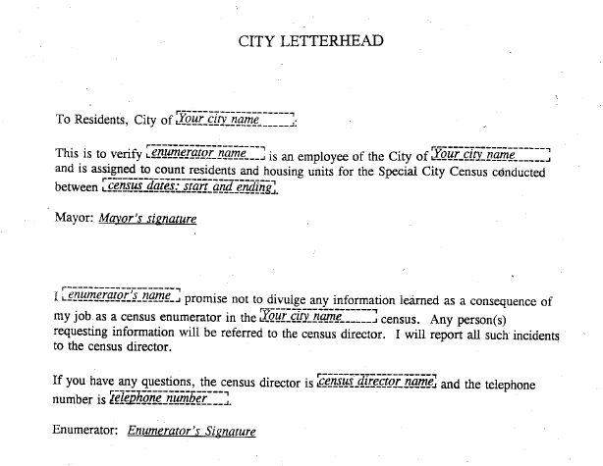
Example of Mayor’s Letter/
Confidentiality Agreement
Notes:
Here is an example of a mayor’s letter and enumerator/census worker confidentiality agreement. Put both on one page so that it is easy to reference. This document must contain signatures from the mayor and the census worker. In addition, it should also contain the census director’s name and contact information.
An ID badge can be printed on the document. Each census worker gets only one copy of the document. They cannot make copies, and must turn it in at the end of their employment or when the census is complete.
This document can then be inserted into a window pocket on the first or last cover of the binder the census worker uses to keep the enumeration forms.

Slide 14
Print and Prepare Field Enumeration Sheet
The census worker needs to know, and be familiar with, all census forms. OFM paper forms must be used and can be found on our website at: http://www.ofm.wa.gov/pop/annex/forms/default.asp
For enumeration you need OFM Census Sheet A – Field Enumeration Sheet
    Pre-enter the city/town name and year or ordinance number only.
    Need one sheet per housing unit, whether occupied or vacant
    Do not use any electronic means to collect and store name and address information. Confidentiality cannot be guaranteed.
Notes:
The census worker needs to know, and be familiar with, all census forms. OFM paper forms must be used and can be found on our website at http://www.ofm.wa.gov/pop/annex/forms/default.asp
OFM Census Sheet A – Field Enumeration Sheet is to be used in the field. You can pre-enter the city name, census year and the ordinance number. Then make copies of the form. This can save some time in the field.
Please note that you should never pre-enter any block number, or address and structure type, or housing unit sequence number. Such information should be collected at the time of interview only. Pre-listed addresses can be wrong and cause problems and confusion during enumeration. Furthermore, names, addresses, housing information cannot be collected using electronic means. Confidentiality cannot be guaranteed if electronic files are created. There is no guarantee that the electronic files will be completely deleted.

Slide 15
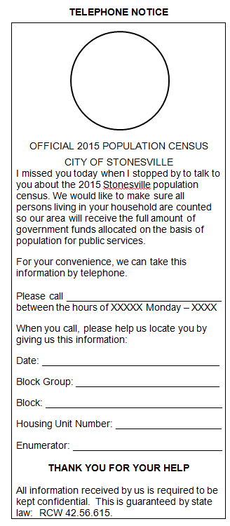
Prepare a Call Back Form
Notes:
If no one is home or the residents refuse to talk at the interview, the census worker should leave a call back form. This door hanger type is an example for you to consider, but you can create one that fits your area.
The census worker should pre-fill the lower part of the form with information to identify the housing unit. This information consists of:
A block group number (or supervisor area number)
A block number
A housing unit sequence number
The census worker’s name.
On the form, you should explain the census activity. It should also include a phone number, office hours, and the confidentiality statement. If residents do call and leave a message with the number of persons in the household, you need to call back in order to screen for legitimate residents in this household.

Slide 16
Prepare Census Supplies
Each census worker should take the following materials out in the field:
  Photo ID badge
  Call back forms
  3-ring binders
    Individual confidentiality agreements
    Census map (with block and enumeration path identified)
    No. 2 pencils (no pens)
    OFM Census Sheet A - Field Enumeration Sheet (with only city, ordinance number/year entered)
    Blank paper for recording questions for OFM
Notes:
Each census worker should take the following materials out in the field:
Photo ID badge
Call back forms
3-ring binders
Individual confidentiality agreements
Census map (with block and enumeration path identified)
No. 2 pencils (no pens)
OFM Census Sheet A - Field Enumeration Sheet (with only city, ordinance number/year entered)
Blank paper for recording questions for OFM

Slide 17
Housing Unit Definitions
Notes:
This is section 2, Housing Unit Definitions
The first census definition you need to know is that of a housing unit. This includes building structure type. Structure type means the number of living units in a specific building and what type of building.
Structure types you may encounter can have anywhere from one to over a hundred units in one building. (You will only categorize up to 5-or-more.) Structure type includes manufactured/mobile home and unusual structures. There are even living structures that are not housing units.
All this will be covered in more detail in this section.

Slide 18
What Is A Housing Unit?
A housing unit is one or more rooms intended for permanent occupancy with direct access from outside the building or through a common hall.
A building is not a housing unit, no matter what it looks like, if
It is dilapidated/ unlivable, and no one lives in there.
It is a new construction with no exterior in place (not weather tight).
It is used entirely for storage or commercial purposes.
Notes:
A housing unit is one or more rooms intended for permanent occupancy with direct access from outside the building or through a common hall.
A building is not a housing unit, no matter what it looks like, if:
It is dilapidated/ unlivable, and no one lives in there.
It is a new construction with no exterior in place (not weather tight).
It is used entirely for storage or commercial purposes.

Slide 19
What Is An Occupied/Vacant Housing Unit?
An occupied housing unit is one with one or more residents usually living and sleeping there.
A vacant housing unit is one where a resident person does not live in the unit as a primary home.
There are two additional types of vacant housing unit situations:
Housing for temporary stay. Examples are: a corporate rental, vacation home, regular hotel/motel, etc. The people in them usually have a different place to call home.
New construction in progress. If it is weather tight, count it. The interior does not have to be complete..
Notes:
An occupied housing unit has one or more resident persons usually living and sleeping there. (Resident definitions are covered later.)
A vacant housing unit has no resident person living in the unit as a primary home.
Also vacant are:
Housing units for temporary stay. Examples are: a corporate rental, vacation home, hotel/motels for transients, etc. The people in them usually have a different place to call home.
New construction in progress. If it is weather tight, it is counted as a vacant unit. The interior does not have to be finished.

Slide 20
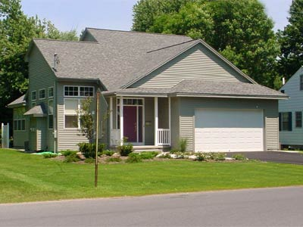
Structure Type: Single Detached
Dwelling (1-Unit)
  The basic features for single family housing are:
  The structure is built to house one family, or household.
  It is detached from any other residential building.
  This category includes modular and prefabricated homes.
Notes:
You are required to collect housing type information. The basic features for single family housing are:
The structure is built to house one family or household.
It is detached from any other residential building; this includes no car ports attached to two structures
This category includes modular and prefabricated homes

Slide 21
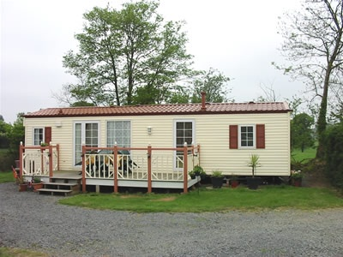
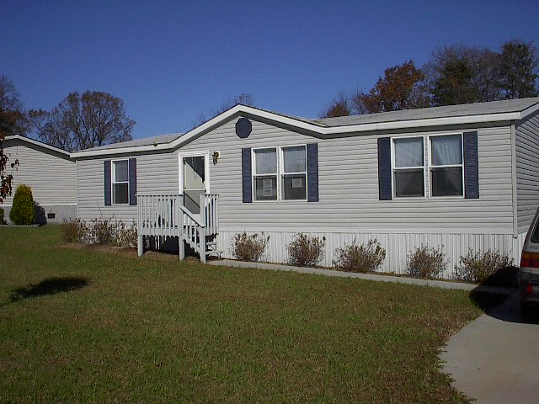
Structure Type: Manufactured Home (MH)
A mobile home, also referred to as manufactured home, are movable housing units intended for permanent occupancy on private lots or in parks. The special features for such units are: they are not built on site and can be moved. They may or may not have a regular foundation.
Notes:
A mobile home, also referred to as manufactured home, are movable housing units intended for permanent occupancy on private lots or in parks. The special features for such units are: they are not built on site and can be moved. They may or may not have a regular foundation.

Slide 22
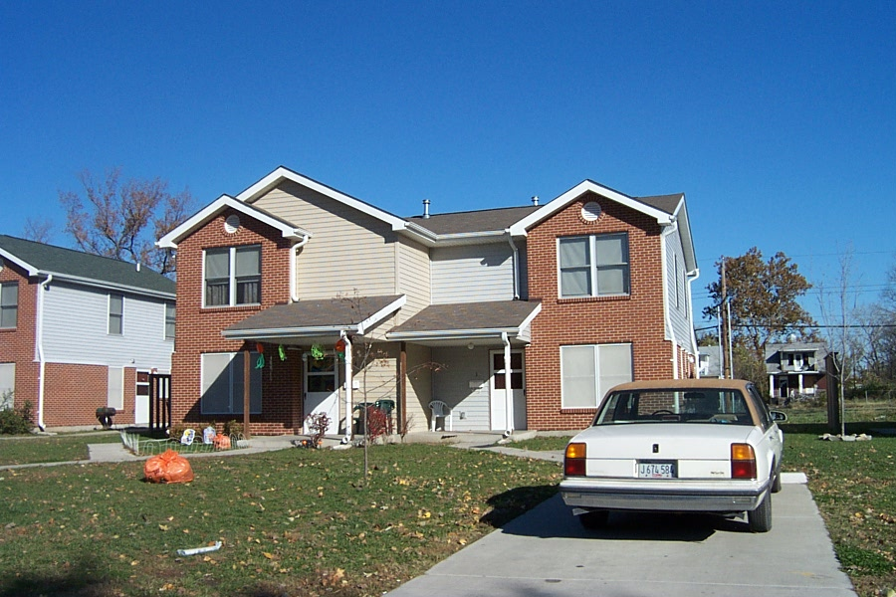
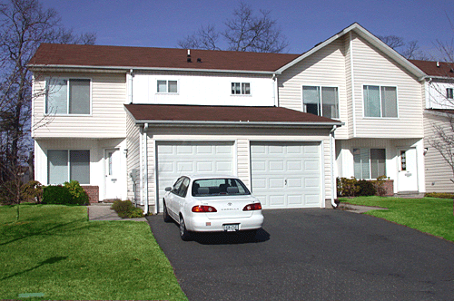
Structure Type: Duplex (2 Units)
A two-unit structure, often called a duplex, is one structure with two housing units in it. The units can be side by side or top and bottom. If two separate units are side by side and joined by a carport, they are considered as a duplex. You need to fill out two field enumeration sheets, one for each unit.
Units side by side
Units top and bottom
Notes:
A two-unit structure, often called a duplex, is one structure with two housing units in it. The units can be side by side or top and bottom. If two separate units are side by side and joined by a carport, they are considered as a duplex. You need to fill out two field enumeration sheets, one for each unit.

Slide 23
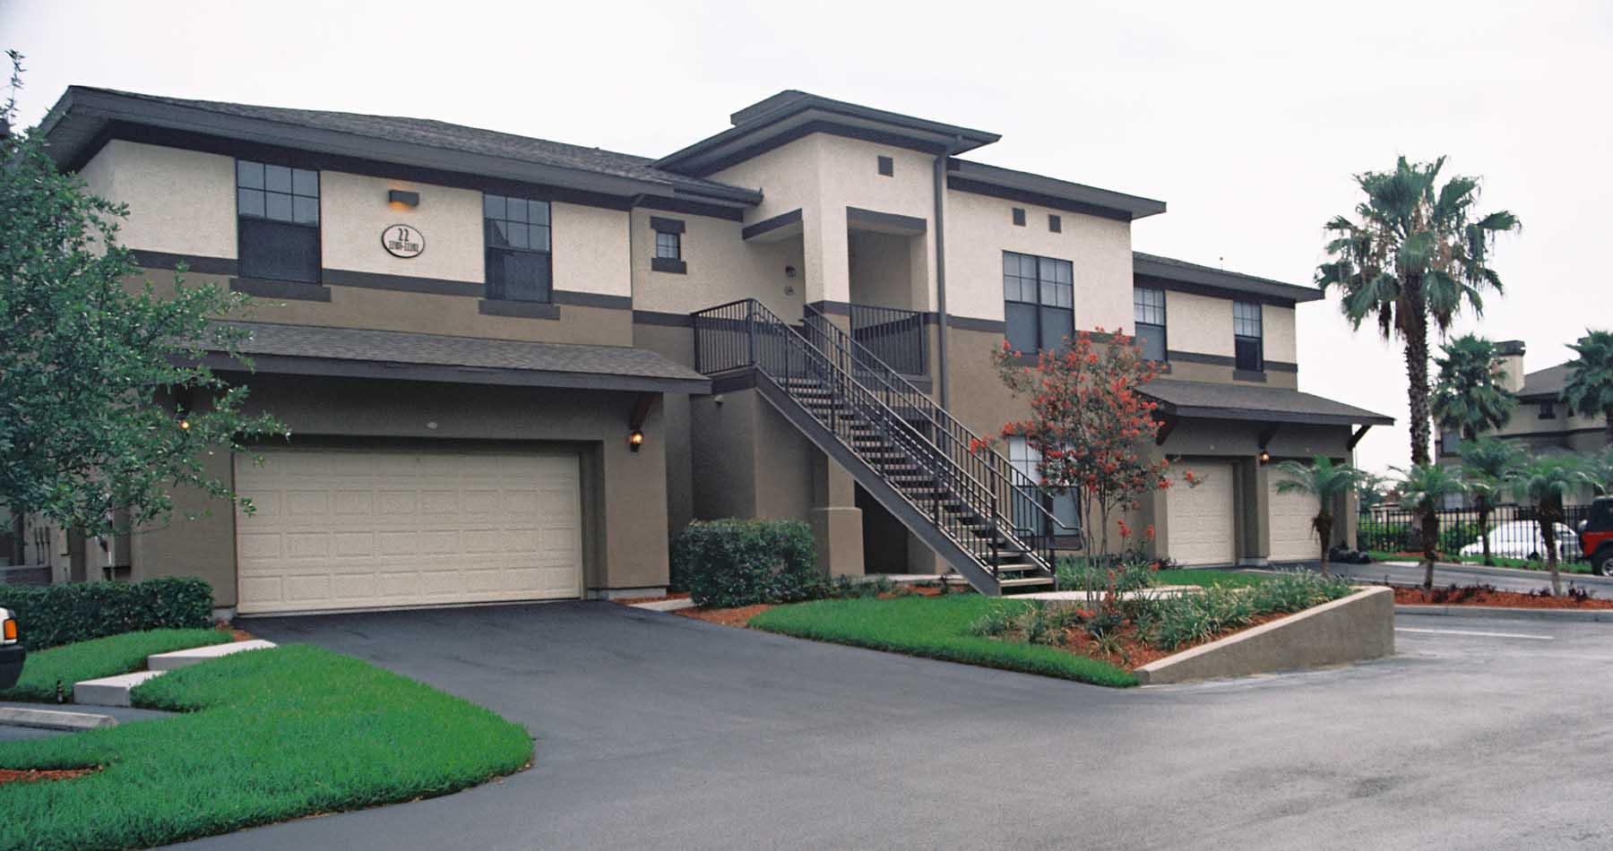
Structure Type: Triplex/Quadraplex
(3-Unit or 4-Unit)
Notes:
This picture shows a combination of side-to-side and up-down 3-unit construction. Sometimes you will see a 4-unit structure with both side to side and up –down units.

Slide 24
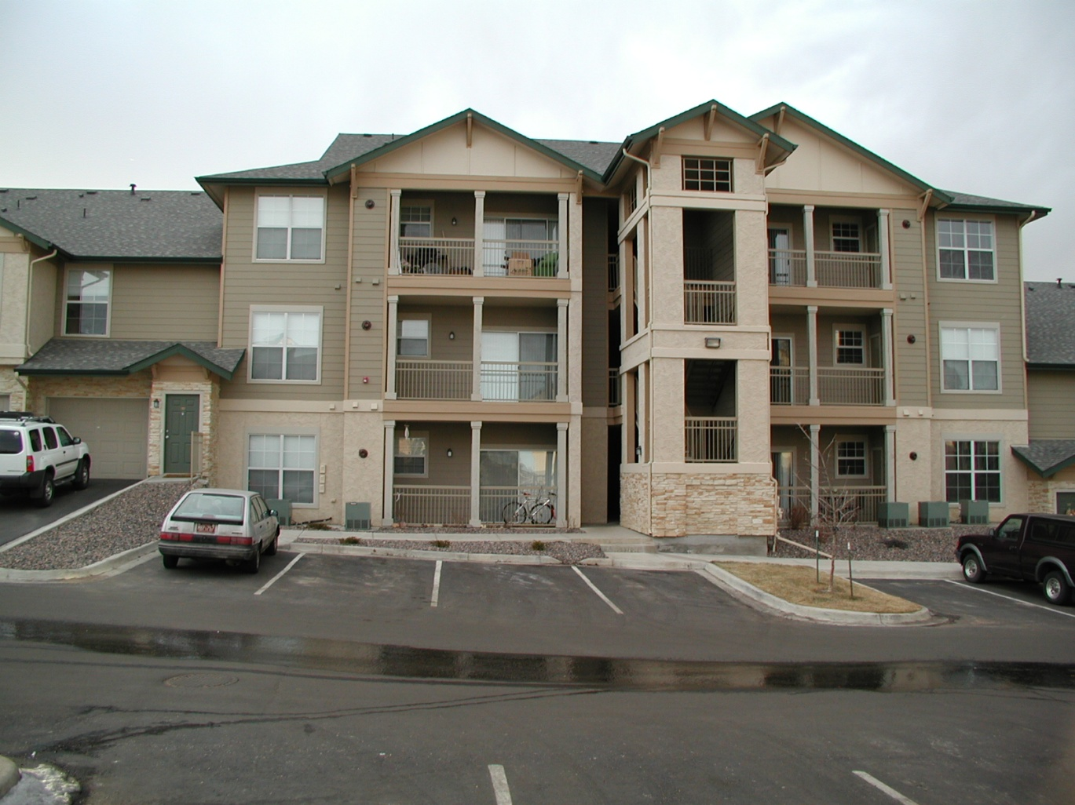
Structure Type: Five-or-More Unit Structure
(5+ units)
Notes:
This is a common structure with 5 or more units in it. Access to the units, in this case, is from the outside for each unit rather than a common hallway. Some structures may have 100 or more units.

Slide 25
Structure Type: Accessory Dwelling Unit (ADU)
Accessory dwelling units (ADUs) are additional living quarters on single-family lots that are independent of the primary dwelling unit. The separate living spaces are equipped with kitchen and bathroom facilities, and can be either attached or detached from the main residence.
If you encounter an ADU, count the main structure as a single family home. Count the ADU as a separate 5+ unit structure on a new field enumeration sheet.
Make notes on your field enumeration sheet that this is an ADU.
Notes:
Accessory dwelling units (ADUs) — also referred to as accessory apartments, second units, or mother-in-law apartments — are additional living quarters on single-family lots that are independent of the primary dwelling unit. The separate living spaces are equipped with kitchen and bathroom facilities, and can be either attached or detached from the main residence. Occupancy rates and the number of people per unit tend to be very similar to 5+ structures.
If you encounter an ADU, count the main structure as a single family home. Count the ADU as a separate 5+ unit structure on a new field enumeration sheet.
Make notes on your field enumeration sheet that this is an ADU.

Slide 26
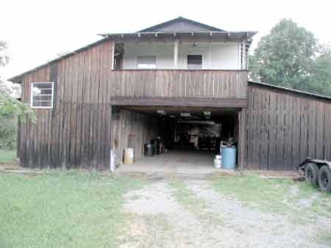
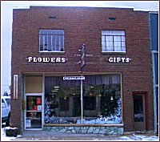
Looking for Concealed Living Units
  Always look for concealed units. Hints for hidden units are:
    Extra mailboxes
    Multiple electricity meters
    RVs in the yard
    Live-in garage
    Always ask about potential units. Sometimes a respondent will report everyone on the property as if in a single residence.
    Always ask a business about apartments in the building.
Notes:
When going from house to house, always look for concealed units. Extra mailboxes, multiple electricity meters, and RVs in the yard are all hints that there may be extra living units near the main house. Another situation is that there may be a live-in unit above the garage. Or a mother-in-law unit (or ADU) in the basement.

Slide 27

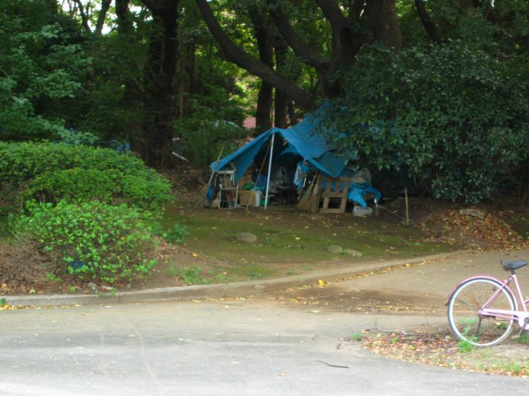
Structure Type: Specials
  Living quarters not intended for permanent occupancy.
  Only count them when occupied – special units can not be vacant.
  Examples include travel trailers, RVs, boats, tents, boxcars etc.
Notes:
Some structures are not originally intended to be permanent living quarters. But, people choose to live in them and not have another living place. Such can be a motor home, travel trailer, boats or boxcars and tents, etc. You count them as housing units only when some one is living in them. There are no vacant special housing units.

Slide 28
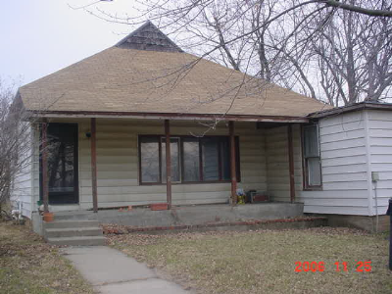
Vacant Housing
Sometimes it is obvious that a unit is vacant when the house is completely empty with no curtains or furniture.
Notes:
A housing unit is considered vacant if it has no resident occupants. Sometimes it is obvious that a unit is vacant when the house is completely empty with no curtains or furniture.
However, you may also run into housing units that are used as storage, time share (persons live elsewhere permanently). You can not determine if the housing is vacant or not until you conduct an interview. Once you have verified that the housing is used for temporary lodging, then mark the unit as vacant.

Slide 29
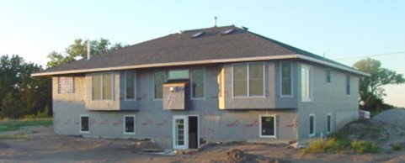
Vacant New Construction (VNC)
For newly built structures, you should count it as a vacant new construction unit if it is weather tight. That is, if the structure has its roof, all outside walls/doors/windows in place, and floor.
Notes:
For newly built and weather tight structures, you should count it as a vacant new construction unit. Usually it has reached the stage where the entire exterior shell is in place. That is, the structure has its roof, and all outside walls, doors, floors and windows are all in place.

Slide 30
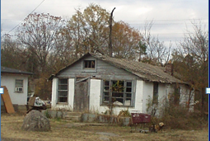
Not Counted If Unoccupied and Dilapidated/Unlivable
Notes:
A dilapidated housing is usually obvious. Do not count it as housing unit unless someone is actually living in it.

Slide 31
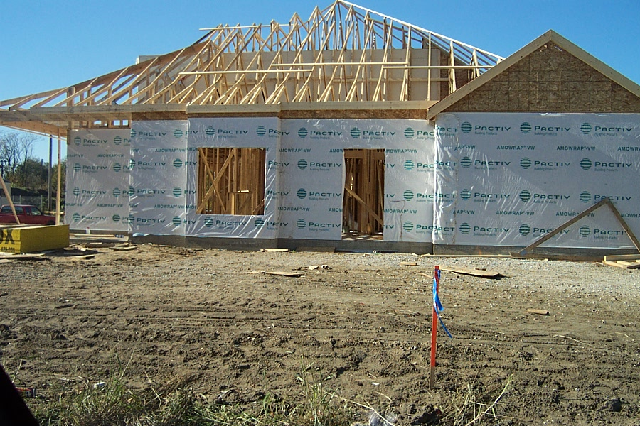
New Construction
But Not a Housing Unit
  If the new construction has no exterior in place, do not count it. It is not weathertight. Do not fill out a field enumeration sheet either.
Notes:
This is new construction without an exterior in place. There are no windows, doors and/or roof. It is obviously not weathertight and should not be counted. Do not complete a field enumeration sheet either. The city will report it later to OFM when it is completed.

Slide 32
Canvassing Procedures
Notes:
This is section 3, Canvassing Procedures
So far, you have learned how to categorize a housing unit. This section will train you how to count residents and block techniques. There two concepts in this section: canvassing technique and enumeration procedure. We will talk about canvassing first.

Slide 33
Canvassing
Canvassing means to go through an area in a systematic manner so that the entire area is examined and no housing units are missed.
A good, complete canvass is essential to the accuracy of a census.
Census workers are responsible for the complete canvass of their assigned area.
Notes:
Counting houses in a systematic manner is known as canvassing.
It means that you go block by block till you cover an assigned area. The entire area should be examined and not miss any housing units.
A good, complete canvass is essential to the accuracy of a census.
Census workers are responsible for the complete canvass of their assigned area.

Slide 34
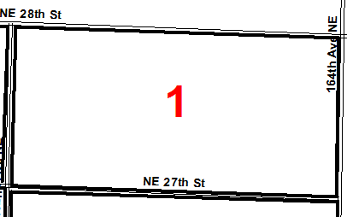
Canvassing Regular Enclosed Block
You will canvass block by block. The most common type is a regular enclosed block. It is rectangular in shape and all sides are roads.
To canvass, find the closest housing unit to the northeast corner. Then enumerate in a clockwise direction. You should be able to stop at the same place as you started without crossing a street.
If you do encounter a street and it does not go all the way to the opposite side of the block (for example, a cul de sac), canvass up one side and then down the other side, and continue around the block.
Notes:
You will canvass block by block. The most common type is a regular enclosed block. It is rectangular in shape and all sides are roads.
For a regular enclosed block, go to the NE corner and start enumerating to your right. There may not be a housing unit there, but you go until you arrive at one.
Then continue in the same direction until you arrive where you started.
You should be able to walk so that you do not have to cross a street. If you do encounter a street and it does not go all the way to the opposite side of the block (for example, a cul de sac), canvass up one side and then down the other side, and continue around the block

Slide 35
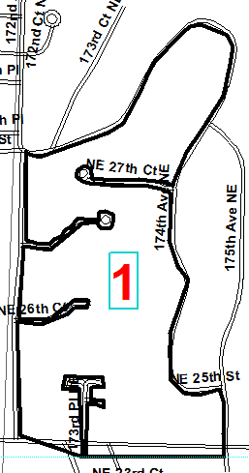
Canvassing Irregular Enclosed Block
  For an irregular enclosed block, all sides are roads, but one or more sides are not straight. Follow the rules as for a regular enclosed block. Your starting point may not be as obvious. But, you should be able to arrive back at the starting point without crossing a road.
X
Notes:
For an irregular enclosed block, all sides are roads, but one or more sides are not straight. Follow the rules for a regular enclosed block. Your starting point may not be as obvious. Just choose a point as close as possible to the NE corner and start enumerating. Again, you will arrive back at the beginning point without crossing a street.

Slide 36
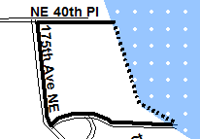
Canvassing Unenclosed Block
  An unenclosed block has at least one boundary that is not a street. A dashed line on the map indicates a border that is not a road.
  Mentally, find the northeast corner and go to the right. Start at the first housing unit encountered. You will not be able to stop at the same place you started.
X
Stop
Start X
Notes:
An unenclosed block has at least one boundary which is not a street. The dashed line on your map indicates a border that is not a road.
You need to find a place to start that will still enable you to go to the right around the block, but, don’t have to stop to re-position yourself and re-start again. Sometimes this is not possible.
If you follow the required clockwise path on this block, you start enumerating at the southeast corner and finish at the northeast corner. You do not try to go along the lakefront. Just enumerate to your right until the last housing unit is done. You will not be able to stop at the same place you started.

Slide 37
Amend the Map If Necessary
Sometimes you may need to amend the map.
If the street does go through the middle of the block to the other side, amend your map so you have two blocks. Draw a line to show two blocks.
Sometimes an alley way is a major throughway and/or the only way to access a housing unit. Label the alley on your map as a block boundary.
In both cases you now have two blocks. Give the newly created block the same number as the original one and add an “A” to it.
Notes:
Sometimes you may need to amend the map.
If the street does go through the middle of the block to the other side, amend your map so you have two blocks. Draw a line to show two blocks.
Sometimes an alley way is a major throughway and/or the only way to access a housing unit. Label the alley on your map as a block boundary.
In both cases you now have two blocks. Give the newly created block the same number as the original one and add an “A” to it.

Slide 38
Empty Block
If there are no residential housing units in the block, it is an empty block
If commercial buildings are found, contact the office and ask about possible on-site living quarters.
Fill out a field enumeration sheet for the empty block and label as vacant.
Notes:
If there are no residential housing units in the block, it is an empty block.
If commercial buildings are found, contact the office and ask about possible on-site living quarters.
Fill out a enumeration sheet for the empty block.

Slide 39
Canvassing: Homeless
Homeless persons do not have a usual place of residence.
May have a temporary bed in a homeless shelter.
If homeless or transients are found
  Inquire if currently living in a shelter. If staying in a shelter, they are counted where the shelter is located. Get name of shelter.
  Inquire if they are currently living in a homeless encampment. They are counted at the encampment. Enlist the help of local agencies that provide services to homeless people.
  If a homeless person is not staying in a shelter and sleeping where night overtakes them, count them as group quarter population.
Notes:
Homeless persons do not have a usual place of residence
They may have a temporary bed in a homeless shelter
If homeless or transients are found
Inquire if currently living in a shelter. If staying in a shelter, they are counted where the shelter is located. Get name of shelter.
Inquire if they are currently living in a homeless encampment. They are counted at the encampment. Enlist the help of local agencies that provide services to homeless people. Do not just wander in and start asking for names.
If not staying in a shelter and sleeping where night overtakes them, count them as GQ population where you find them.

Slide 40
Canvassing-Summary
  Canvass blocks in a methodical way.
  Start at northeast corner of the block if possible and travel in a clockwise direction.
  If there is a conflict with starting in the NE corner and going to the right, going to the right takes precedence
  If you need to deviate from the rules for safety reasons- like one way street- be consistent and document your reasons on enumeration map.
  For multi-unit structure, be consistent and methodical. Always finish a building before continuing on to the next structure.
  Do not count empty spaces in a manufactured home park as a vacant manufactured home.
  Keep track of empty spaces in a park.
Notes:
Canvass blocks in methodical way.
Start at northeast corner of the block if possible and travel in a clockwise direction.
If there is a conflict with starting in the NE corner and going to the right, going to the right takes precedence
If you need to deviate from the rules for safety reasons- like one way street- be consistent and document your reasons on enumeration map.
For multi-unit structure, be consistent and methodical. Always finish a building before continuing on to the next structure.
Do not count empty spaces in a manufactured home park as a vacant manufactured home.
Keep track of empty spaces in a park.

Slide 41
Enumeration Procedures
  Know who to count based on resident rules
  Know how to record residents using OFM Census Sheet A – Field Enumeration Sheet
  Know how to interview residents.
Notes:
Now that you have learned how to canvass an area, it is time to learn how to enumerate the residents living in the area. You will learn how to count people based upon the residency rules. Also, you will learn how to use the OFM Census Sheet A – Field Enumeration and how to conduct an interview.

Slide 42
Know Who to Count and How to Count Them
  Who to count:
    Resident- A person who usually lives and sleeps in the housing unit or facility for the majority of the year (6 months or more) or has no other usual place of residence. Do not count people who are visiting, or stay here temporarily with a usual residence elsewhere, such as college students home for summer vacation.
  How to count them
    List all the names of residents who live in the household, starting with an adult on the field enumeration sheet
    Screen the information you just recorded using the questions at the bottom of the page. The questions are designed to make sure that short-term stay persons are not included and no eligible persons are missed
Notes:
As an enumerator, you need to know who to count:
Resident- A person who usually lives and sleeps in the housing unit or facility for the majority of the year (6 months or more) or has no other usual place of residence. Do not count people who are visiting, or staying here temporarily with a usual residence elsewhere, such as college students home for summer vacation.
Then, you must know how to count them:
List all the names of residents who live in the household, starting with an adult on the field enumeration sheet.
Screen the information you just recorded using the questions at bottom of page. The questions are designed to make sure that short-term stay persons are not included and no eligible persons are missed.

Slide 43
Residence Rules
Person: | Resident of:
Lives in the housing unit, temporarily away. (e.g., vacation, hospital, traveling job) | This housing unit
Lives in house on weekends, works and has a room or apartment elsewhere | The other place. DO NOT LIST
Persons in the Armed Forces who live in this household when they are not deployed | This housing unit.
Persons in the Armed Forces who live in military quarters on base | The military quarters on base. DO NOT LIST
Persons in the Armed Forces who are stationed/deployed overseas. | Their overseas location. DO NOT LIST
College students who do not live in this household during school year | Place where he/she lives while attending school. DO NOT LIST
Persons who divide their time equally between homes | Where they are at the time of the census
Persons who divide their time unequally between homes | Where they spend the majority of the year
Notes:
Whether or not to count someone is dependent upon their living situation. We are now going to review the most common situations. This table can also be found in the Enumerator’s Manual. The situation: You have received the names for people living in the housing unit you are at. Now you are checking residency and the respondent indicates one of the following situations:
Person lives in the housing unit, temporarily away. (e.g., vacation, hospital, traveling job: The person is a resident of this housing unit.
Person lives in house on weekends, works and has a room or apartment elsewhere: The person is a resident of the other place. DO NOT LIST IN THIS HOUSING UNIT.
Persons who are in the Armed Forces who live in this household when not deployed. The person is a resident of this housing unit
Persons in the Armed Forces who live in military quarters on base. They live in the military quarters on base and not this housing unit.
Persons in the Armed Forces who are stationed/deployed overseas. They live overseas and are not counted at this housing unit.
College students who do not live in this household during school year. Count them where they live while attending school. DO NOT LIST in this housing unit.
Persons who divide their time equally between homes. Count them where they are at the time of the census.
Persons who divide their time unequally between homes They are to be counted where they spend the majority of the year.

Slide 44
Residence Rules (continued)
Person: | Resident of:
Homeless or transients with no usual residence | Where they are found during the census
Homeless or transients with no usual residence | If staying in a shelter or encampment, the shelter or encampment. Otherwise, where they are found.
Person who lives in a house but sleeps at own residence (e.g., nanny, domestic help) | Place where he/she normally sleeps. DO NOT LIST
Persons in institutions for long periods of time (e.g., nursing homes, correctional facilities) | The institution. DO NOT LIST
Notes:
Homeless persons or transients with no usual residence. Count them where they are found during the census unless they live in a shelter or homeless encampment at the time you contact them.
Homeless persons or transients with no usual residence but staying in a shelter or encampment. Count them at the shelter or encampment.
Person who lives/works in a house but sleeps nights at own residence (e.g., nanny, domestic help). Count them where he/she normally sleeps. Do not list as resident at this housing unit.
Persons in institutions for long periods of time (e.g., nursing homes, correctional facilities). They should be counted at the institution. Do not list at this housing unit.
If a situation is not listed in any of the Residence Rules tables, just apply the definition of a resident. If you are still having trouble, talk with your supervisor.

Slide 45
How to Fill Out the Field Enumeration Sheet
Notes:
This is section 4, How to fill out the field enumeration sheet.
This section shows you how to complete the OFM Census Sheet A - Field Enumeration. This form collects all relevant information about the housing unit and anyone resident there. You must complete a form for each housing unit. For example, two separate sheets for a duplex, three sheets for a triplex, and as many as needed for multi-unit structures.

Slide 46
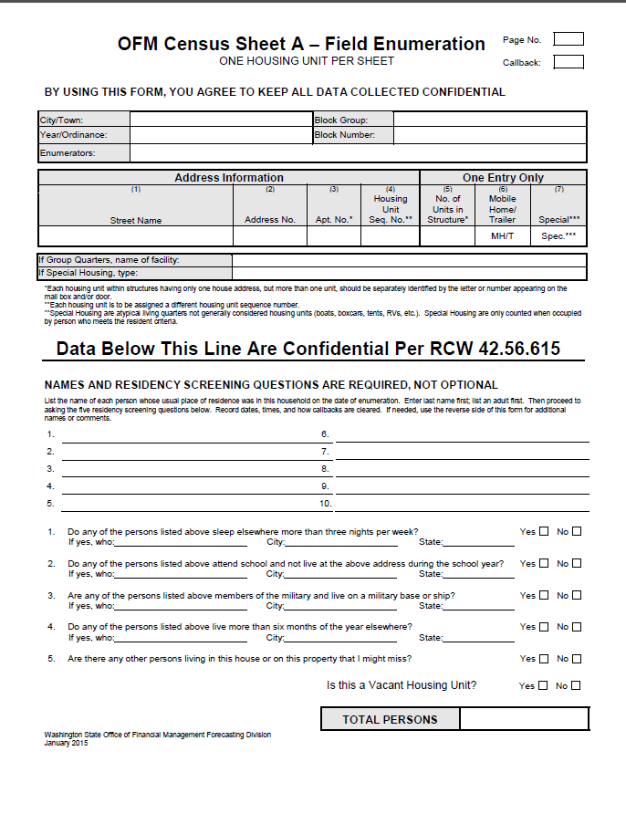
Field Enumeration Sheet
}
}
}
}
Notes:
This is the Field Enumeration Sheet. It is the form used by census workers to collect the housing and population data for a census.
It can be viewed as having four sections.
[click for animation] In all cases, you need to fill out the first section. The city/town, calendar year/ordinance number, Block number, and enumerator are identified. Every sheet used needs this information
[click for animation] The second section holds the address and structure type information.
If the structure is a group quarters facility, a box to record the facility name is given
If the structure is a special housing unit, a box to record the type of special is given
[click for animation] The third section is where the residents’ names are written, one name per line. If the housing unit is vacant, no names will be written down. Write the word “vacant” in this section.
[click for animation] The fourth section contains the questions that help determine residency status. The respondents often give the names of persons who do not count as a resident. These questions help identify who does or does not qualify as a resident. This is the section where the housing unit is labeled as vacant or not.
Each section will be discussed in detail on the following slides.

Slide 47
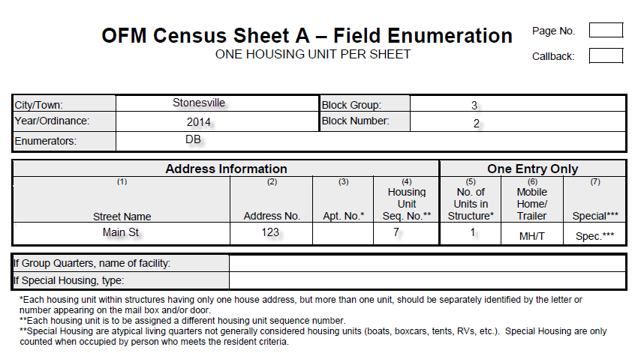
Prepare Field Enumeration Sheet
1
Before you walk to the door, fill out the first section of the census form. It is used to record location and enumerator information. Enter the following:
  The city/town name. (This may be pre-filled.)
  The calendar year or the ordinance number. (This may be pre-filled.)
  Initial this form in the enumerator space. Every enumerator who uses the form needs to initial it.
  Fill in the block group and block number.
  In the upper right corner, enter the page number. Start with “1” for each block.
  If this is a return visit, the Callback box should have a “C” in it.
Notes:
This is the first section of the Field Enumeration Sheet. This section must be filled out for each form prior to your interview. It is used to record location and enumerator information. Enter the following information in the appropriate cell:
The name of the city/town
The calendar year, if it is April 1 census, or ordinance number if for an annexation.
The initials of each enumerator that works on this housing unit.
Fill in the block group and block number.
In the upper right corner, the page number and the callback box. If this is a return visit, this box should have a “C” entered.

Slide 48
Prepare Field Enumeration Sheet
This next section of the form is used to record information about the housing unit. None of these items should be pre-entered on the form.
When you interview the residents, make sure to verify the address and structure type.
Notes:
The second section is to record information about the housing unit at your next interview. Enter this information before the interview starts as you walk to the unit.
The information needed is: street name, house address, apartment number if applicable, housing unit sequence number, and structure type.
The street name is the street the housing unit’s front door faces. Of course, the house address is the number assigned to the housing unit. The apartment number/letter helps uniquely identify a multi-unit if it does not have a separate house address. Since the housing structure type is needed, if a unit is stick built, enter a number from 1 to 5 in column 5. If the unit is a manufactured home or a special, circle the relevant type in either column 6 or 7.
The housing unit sequence number is assigned to a housing unit sequentially as you do your interviews. Start with sequence number “1” with the first housing unit in each block.
When you interview the residents, make sure to verify the address.

Slide 49
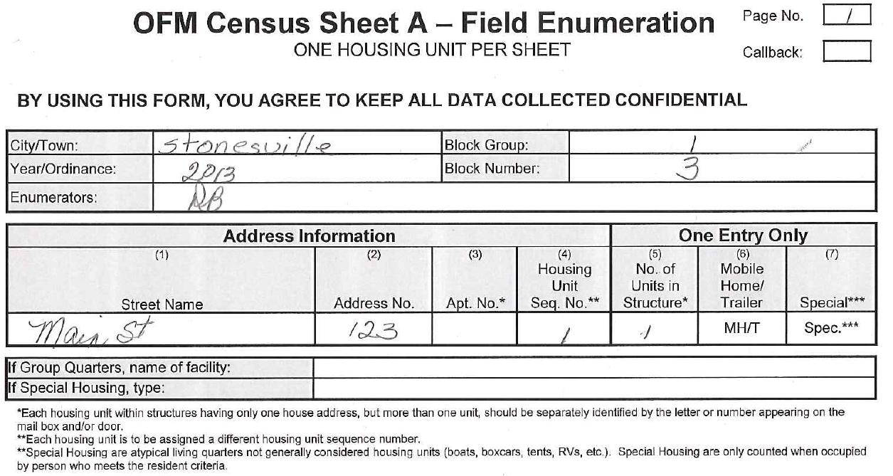
  Example of Completed Top Half of the
  Field Enumeration Sheet
Notes:
This is an example of the top section filled with appropriate information.

Slide 50
Field Enumeration Sheet
Resident Names
Notes:
The third section is for recording residents’ names. Names are required.
The form has room to write ten names. If there are more than ten names to record, just write “over” and continue writing on the back.
Do not erase unless you either wrote a wrong name or misspelled a name
Get complete names, not just first names, or not just a number of persons living in the unit.
If names are refused, record that fact.
Refused names should be recorded as “adult male” “adult female” “child male” “child female”
Try to get names from neighbors.

Slide 51
Interview: Basics
  Wear a badge and identify who you are and why you are there
  Show mayor’s letter and pledge of confidentiality
  Do not go inside the housing unit even if invited
  Hand out city promotion material if there is any
  Ask for a competent person to gather the initial information
  Ask for full names of persons living in this unit
    E.g. “I need the names of the persons usually living in this house (or apartment) starting with an adult.”
  Write the names in pencil
  Erase only to correct names and addresses
  Ask about potential other housing units on the property
  Ask a business if the building contains units for people to live in permanently
Notes:
When you walk to the house, you should always wear a picture badge. When the resident answers the door, identify who you are, and why you are there. You should hand out any city promotion material and ask for a competent person to answer your questions.
Show the mayor’s letter and pledge of confidentiality. And your ID badge.
Please remember to never go inside the housing unit even if you are invited.
Once the resident agrees to do the interview, you can start by saying something like ”I need the names of the persons living here, starting with an adult.” As mentioned before, full names are needed, not just first names.
You should write the names in pencil, and erase only to correct names and addresses.
Ask about potential other housing units on the property
Ask a business if the building contains units for people to live in permanently

Slide 52
Interview: Basics (continued)
  Inquire about neighboring housing units
    “Could you tell me who lives next door in case they’re not home?”
    If no contact at prior housing unit, ask if they know who lives there.
  If no one answers the door, make sure you create an OFM Census Sheet A - Field Enumeration sheet for it.
    Note on the back the date and time you were there.
    Put a “C” in the “Callback” box in the upper right corner
  Leave a door hanger at the time of initial canvass. Note this action in your comments.
Notes:
It is a good practice and is very helpful to ask information about a neighbor during an interview. You can say something like: “ Could you tell me who lives next door in case they’re not home?” This will give you valuable information on how much the neighbor knows. If you lack information concerning the prior house, go ahead and ask.
If no one answers the door, make sure you have created an OFM Census Sheet A - Field Enumeration sheet for it.
Note on the back the date and time you were there.
Put a “C” in the “Callback” box in the upper right corner
Leave a door hanger at the time of initial canvass. Note this action in your comments.
Continue to the next housing unit.

Slide 53
Interview: Screening
Screen the information you have recorded. Ask about persons who may be away for a short time but normally live in this household
Ask if there is a new baby still in the hospital.
Next, using the first four screening questions at the bottom of the form to help determine residency status.
If needed, void wrong entries. Do not erase.
  Void if person mistakenly gives a wrong name
  Void if person listed is not a resident. But do not void in front of respondent. Respondent tends to object when a family member is eliminated from the census.
The fifth screening question is designed to find hidden housing units that may be on the property. A relative or friend may be staying in an RV or onsite apartment. The person(s) in this unit may or may not have been included with the main family. A separate form is needed for an additional housing unit.
Notes:
Screen the information you have recorded. Ask about persons who may be away for a short time but normally live in this household
Ask if there is a new baby still in the hospital.
Next, use the first four screening questions at the bottom of the form to help determine residency status.
If needed, void wrong entries. Do not erase. To void, draw a line through the name and write “void” beside the name
Void if person mistakenly gives a wrong name
Void if person listed is not a resident. But do not void in front of respondent. Respondent tends to object when a family member is eliminated from the census. Write the reason next to name (e.g., “at college”). Do the “void” on your way to the next housing unit
The fifth screening question is designed to find hidden housing units that may be on the property. A relative or friend may be staying in an RV or onsite apartment. The person(s) in this unit may or may not have been included with the main family. A separate Field Enumeration Sheet is needed for an additional housing unit.

Slide 54
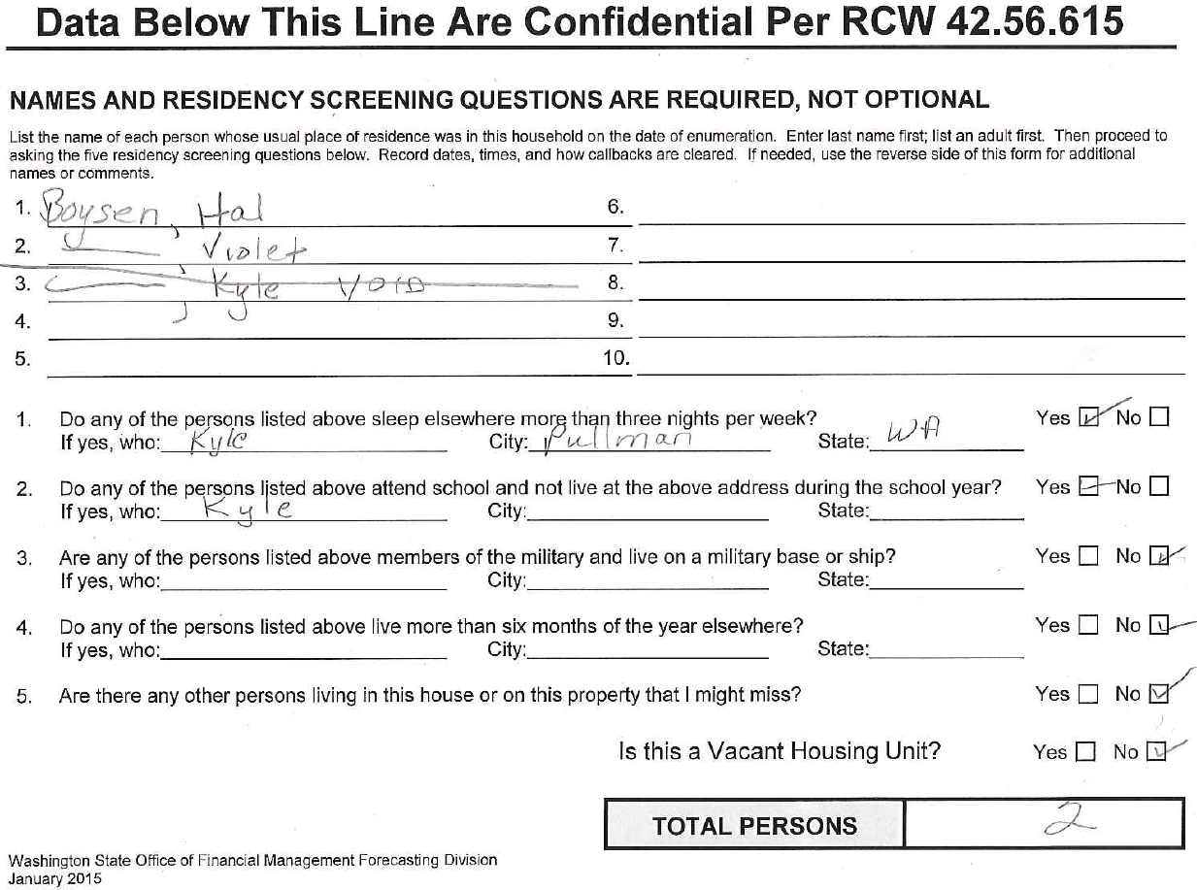
Interview: Screening Example
Notes:
This example demonstrates the result of a complete interview of a household. The census worker originally recorded three persons living in this household. During screening he found out that Kyle is a college student who lives where he is attending college. So the census worker wrote void next to Kyle’s name and counted two persons as eligible residents in this household.

Slide 55
Callbacks
  If nobody is home, you need to
        Complete top of Field Enumeration Sheet, put a “C” in the Callback box in the upper right corner of the form.
        Record date and time on the back of the sheet
        Put your initials at the top in the appropriate box
        Get information from neighbors
          Names of residents, places of employment, when family is home, etc.
          If you can verify the same information from two neighbors, you do not need to try to contact residents again. Just complete the form with the information provided by the neighbors, and document from whom you received information. Clear the callback, by making a diagonal cross through the letter “C” you entered in the box in the upper right corner of the form
Notes:
When no one is home to answer the door, you still need to complete the top section of the Field Enumeration Sheet, put a “C” in the callback box and record the date and time you visit the housing unit. Do the same if someone answers the door but absolutely refuses any information. Be sure to write a note about this situation.
If you can verify the same information from two neighbors, you do not need to try to contact residents again. Just complete the form with the information provided by the neighbors, and document from whom you received information. Then clear the callback, by making a diagonal cross through the letter “C” you entered in the box in the upper right corner of the form.

Slide 56
Vacant Housing Unit
You still need to complete a Field Enumeration Sheet for a vacant housing unit. Then in the names section just write “vacant.”
If it is a new construction that qualifies for inclusion in the census, write “VNC.”
No need for a Field Enumeration Sheet if the structure in front of you is a dilapidated house or is an unoccupied special like an RV or tent.
Notes:
You are at the front door of a housing unit. You are able to determine that it is vacant.
You still need to complete a Field Enumeration Sheet for the unit. Complete the first and second sections. In the middle section instead of names, just write “vacant.” If it is a new construction that qualifies for inclusion in the census, write “VNC.”
If no housing units are found in a block, a Field Enumeration Sheet needs to be completed for the block. Complete the top sections of the form and write “empty block” in the middle section
No need for a Field Enumeration Sheet if the structure is not considered a housing unit such as dilapidated house, or special like RV or tent.

Slide 57
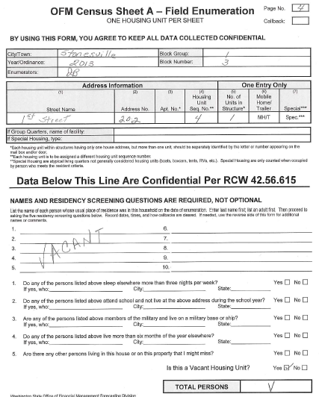
Field Enumeration Sheet: Vacant Housing
Notes:
Here is a completed sample Field Enumeration Sheet for a vacant house. The top sections are filled in normally. The middle section does not have any names. The word “Vacant” is written in this section on an angle. The angle helps assure that population will not be counted accidentally.
There is no need to answer the questions since no one lives here. Check “yes” that this unit is vacant down at the bottom. In the “Total Persons” box, enter a “V.”

Slide 58
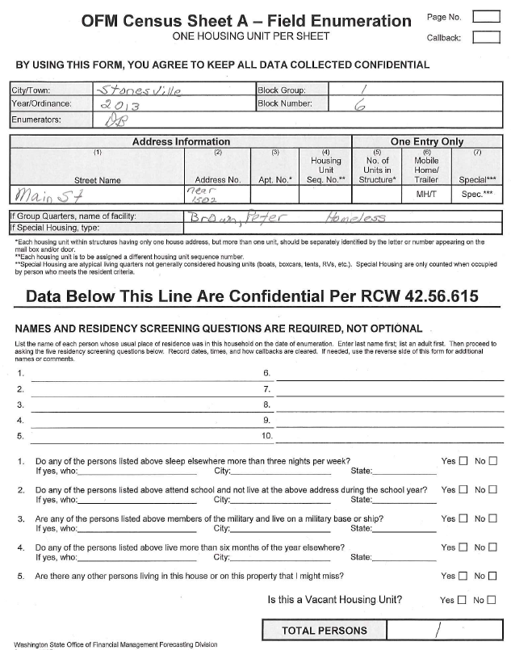
Field Enumeration Procedure: Homeless
Notes:
The last situation you may encounter is a homeless person. If you encounter homeless people who do not live in any shelter, list street location where you found him/her as the home. Write the person’s name and “homeless” on GQ “Name of Facility” line. Do not write anything in the middle section.

Slide 59
Problem Situations
  If you encounter people who appear to be resistant and angry, politely excuse yourself.
  Try to get information from neighbors.
    Names are preferred, but descriptions such as: “adult male, female child, etc.” are acceptable as long as the number of instances are few in number overall in the census.
    Document situation – use the back of the form as needed.
    If you have questions please contact OFM
  When you see “No Trespassing” signs, do not walk to the door. Create a census form for the housing unit. Write comments describing the situation..
  Feel free to give our phone number to people who would like to verify the census: 360-902-0599
Notes:
If you encounter people who appear to be resistant and angry, politely excuse yourself.
Try to get information from neighbors.
Names are preferred, but descriptions such as: “adult male, female child, etc.” are acceptable.
Document situation – use the back of the form if needed.
If you have questions please contact OFM.
When you see “No Trespassing” signs, do not walk to the door.
Feel free to give our phone number to people who would like to verify the census: 360-902-0599

Slide 60
Frequently Asked Questions, Important Considerations, and Paperwork Submittal
Notes:
This is Section 5, frequently asked questions, important considerations, and paperwork submittal

Slide 61
Frequently Asked Questions
  Who receives this information? Is it protected?
    This information is confidential and is protected by state law.
    The enumerator is not allowed to give the census sheets to anyone not involved in the census
    The city is not allowed to make copies of any field enumeration sheet except blank forms
    After tallying, all sheets are sent to the state. The state destroys the paperwork after verifying numbers
    Reassure resident by showing letter signed by the mayor and the enumerator that shows agreement to keep information confidential
Notes:
Who receives this information? Is it protected?
The first most asked question is about confidentiality. Census data are protected by state law. No one is allowed to give the field enumeration sheets to anyone not involved in the census. None of the paperwork is kept or copied by the city. It all is sent in to the state who destroys confidential papers when finished with them.
You can also show your mayor paragraph and signed confidentiality statement to the residents to reassure them.

Slide 62
Frequently Asked Questions
  What’s the purpose of this census?
    The population number will be used to allocate state government funds for public services.
    The population numbers will be used in health, transportation and public school planning
Notes:
What is the purpose of this census?
The purpose of this census is to collect as accurate a population count as possible. There are monies that are disbursed to cities and towns based upon population.
There are approximately 200 RCWs that use population numbers in one way or another for funding and other purposes.

Slide 63
Frequently Asked Questions
  Why are the full names required?
    The names are used to verify that people are not missed or double counted in the census.
    Names are used for field checking
    If census is tabulated with > 5% no-names, census workers may be required to re-canvass the area
Notes:
Why are the full names required?
Names are used to verify that persons are only counted once. Also, they help to add any missed persons and eliminate double counts.
OFM can randomly check census results.
If there are more than 5% no names tabulated, census workers may have to re-canvass an area.

Slide 64
Safety
• Contact the local police to let them know a census is being conducted
Let them know census workers will be in the field.
Provide enumeration dates, the enumeration location, and census workers’ names.
• Each census worker should carry a cell phone and should contact emergency services (e.g. 911) first in case of emergency.
Send census workers to the field in pairs when there is concern about safety.
Be sure your enumerators understand safety policies and procedures
• Be dressed appropriately for the weather
• Wear high visibility clothing and bring flashlights for night work.
IMPORTANT:
Be alert and pay attention to current news. You may not be aware of hazardous situations until the census workers are in the field. Be prepared to make adjustments like changing their work location as needed on a moments notice.
Notes:
You should also try to safeguard the census worker’s safety best you can. Several things you can do to achieve that.
Contact the local police to let them know a census is being conducted. Provide enumeration dates, the enumeration location, and census workers’ names.
• Each census worker should carry a cell phone. They may need to contact help in an emergency.
In an emergency situation census workers should contact emergency services (e.g. 911)
Send census workers to the field in pairs when there is concern about safety. This may be due to hazardous weather, poor roads, high crime or hostility toward the census.
Be sure your census workers understand safety policies and procedures
• Be dressed appropriately for the weather
• Wear high visibility clothing and bring flashlights for night work.
IMPORTANT:
Be alert and pay attention to current news. You may not be aware of hazardous situations until the census workers are in the field. Be prepared to make adjustments like changing their work location as needed on a moments notice.

Slide 65
Common Mistakes
  Underestimate the time required to do a census
  Unclear about the tasks and requirements of a census.
  Inadequately prepared maps
  Inadequate quality control
Notes:
It is easy to make mistakes or to inadequately prepare for a census. The most common mistakes are:
Underestimating the time required to do a census. The estimated time should include both the interview and the commute to the next housing unit. The average interview portion lasts about 4 minutes but commute time varies depending on density. Following up on hard to reach households takes a lot of time and effort.
Second, the census worker is unclear about the tasks and requirements of a census.
Third, maps used are not adequately prepared or updated. This can lead to confusion, double coverage, or missing housing units during canvassing.
Forth, census workers need to be detail oriented and double check their work looking for mistakes or missed housing units.

Slide 66
Filing with OFM
View the tabulation training for instructions on how to fill out the various tabulation sheets and send all documentation to:
  Forecasting and Research Division
  Office of Financial Management
  Room 318
  210 11th Ave SW
  P.O. Box 43124
  Olympia WA 98504-3124
If using FedEx, UPS, etc., the zip code is 98501.
If you have questions about a census, census definitions and/or procedures, please contact us at:
Forecasting and Research Division
Pop.annexations@ofm.wa.gov
360-902-0599
Notes:
View the tabulation training for instructions on how to fill out the various tabulation sheets and send all documentation to:
Forecasting and Research Division
Office of Financial Management
Room 318
210 11th Ave SW
P.O. Box 43124
Olympia WA 98504-3124
If using FedEx, UPS, etc., the zip code is 98501.
If you have questions about a census, census definitions and/or procedures, please contact us at:
Forecasting and Research Division
Pop.annexations@ofm.wa.gov
360-902-0599

