Slide 1
OFM OneWa Project Team Budget Update on Allotment
TOPIC
June 05, 2024

Slide 2
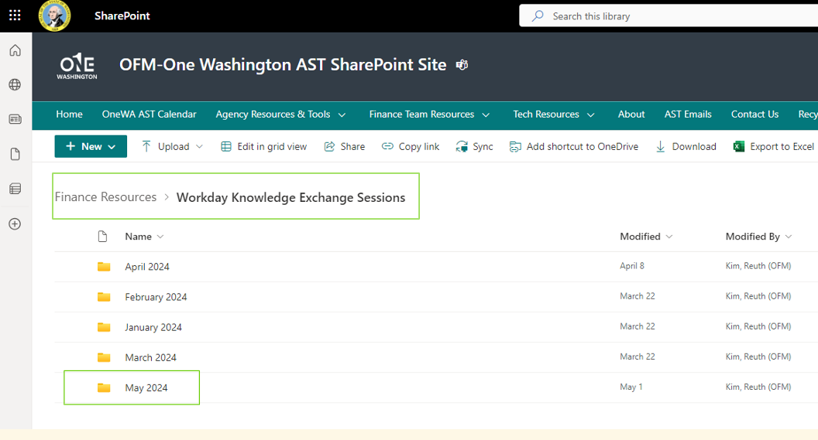
Knowledge Exchange Sessions & E2E Testing Sprint 2
5.22.24 Appropriation and Budget Activity Worktags and Hierarchies
6.05.24 Demo in WD using both Workday User Interface (UI) and EIB (Enterprise Interface Builder)
6.24.24 Budget Testing Session – 3 Test Scenarios total (Operating, Capital & Transportation Allotment)
AST SharePoint Site – Knowledge Exchange Folder
2

